Slide 1



FW 3.4
Wifi Training - Hands On
Brazil Application

Slide 2
Labs Prerequisites
2
Hardware
NUCLEO-F401
X-NUCLEO-IDW01M1
Utility software
Tera Term: terminal emulator (available from http://en.sourceforge.jp/projects/ttssh2/releases)
Text Editor
Web browser
CubeMX
ODE firmware
CubeMX wifi: en.x-cube-wifi1_firmware.zip

Slide 3



STM32 Open Development Environment Fast, affordable Prototyping and Development
The STM32 Open Development Environment (ODE) consists of a set of stackable boards and a modular open SW environment designed around the STM32 microcontroller family.
STM32Cube development software
STM32 Nucleo expansion boards
STM32 Nucleo development boards
STM32Cube expansion software
Compatibility with multiple Development environments
www.st.com/stm32ode

Slide 4
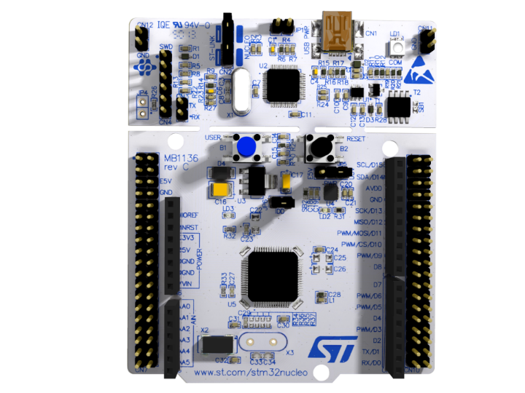









STM32 Nucleo Development Boards (NUCLEO)
A comprehensive range of affordable development boards for all the STM32 microcontroller series, with unlimited unified expansion capabilities and integrated debugger/programmer functionality.
Power supply through USB or external source
STM32 microcontroller
Integrated debugging and programming ST-LINK probe
Complete product range from ultra-low power to high-performance
ST morpho extension header
Arduino™ UNO R3 extension headers
www.st.com/stm32nucleo

Slide 5





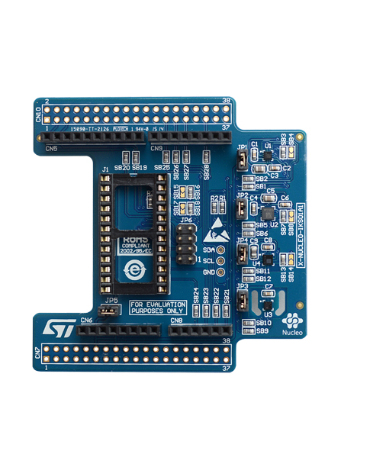






STM32 Nucleo Expansion Boards (X-NUCLEO)
Boards with additional functionality that can be plugged directly on top of the STM32 Nucleo development board or stacked on another expansion board.
Connect
Power
Move/Actuate
Interact
Sense
Motion MEMS sensors
Environmental sensors
DIL24 support for new devices
Example of STM32 expansion board (X-NUCLEO-IKS01A1)
www.st.com/x-nucleo

Slide 6

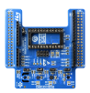

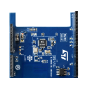
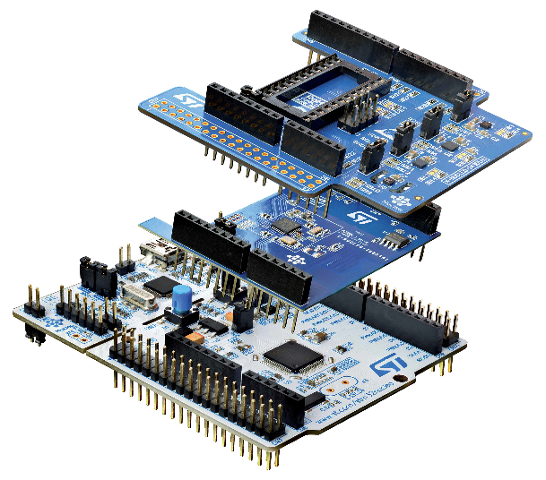

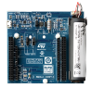

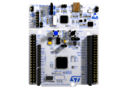




STM32 Open Development Environment Building block approach
The building blocks
Your need
Our answer
Accelerometer, gyroscope
Sense
Inertial modules, magnetometer
COLLECT
Pressure, temperature, humidity
Proximity, microphone
Bluetooth LE, Sub-GHz radio
Connect
TRANSMIT
NFC, Wi-Fi, GNSS
Audio amplifier
Translate
ACCESS
Touch controller
Operation Amplifier
Stepper motor driver
Move / Actuate
CREATE
DC & BLDC motor driver
Industrial input / output
Power
POWER
Energy management & battery
General-purpose microcontrollers
Process
PROCESS
Secure microcontrollers
Software
www.st.com/stm32ode

Slide 7
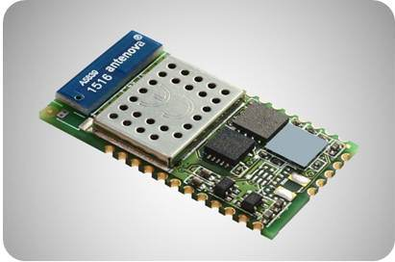
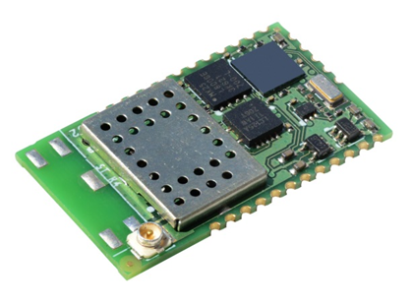
Connectivity: SPWF01S – Wi-Fi modules
The SPWF01S is a “Cloud Compatible” Wi-Fi Modules embedding all the FW e.g. TLS/SSL security, Rest API, to easily connect Sensors and Actuators to Remote Cloud Services
2.4 GHz IEEE 802.11 b/g/n low power transceiver
STM32 ARM Cortex-M3 microcontroller
Integrated high gain antenna or u.fl connector
Pre Certified RF (FCC, IC, CE, SRRC)
1.5 MB or 512 kB Integrated Flash memory
Integrated TC/IP and Application Layer Functions
Integration
Flexibility and ease of use
SPWF01SA Integrated antenna
Easy interface to host Microcontroller through UART and AT commands set
TLS 3.0/SSL 1.2 for End to End security integrated
System Modes: Mini-AP, IBSS and Station
Built-in Application: Sockets, Web Server, Rest API
Over The Air firmware and external flash update
Easy configuration (SSID, PWD) in miniAP
Up to +18 dBm output power
RF power
SPWF01SC Integrated U.FL connector
Small form factor: 26.92 x 15.24 x 2.35 mm
Size
www.st.com/wifimodules

Slide 8
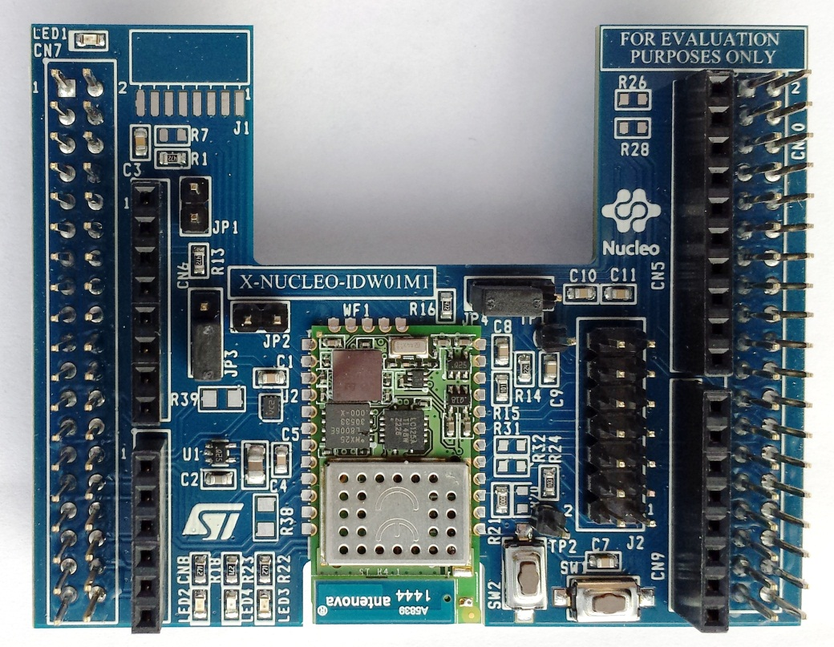
Wi-Fi expansion board (X-NUCLEO-IDW01M1) Hardware Overview (1/3)
X-NUCLEO-IDW01M1 Hardware Description
TheX-NUCLEO-IDW01M1 is a Wi-Fi evaluation board based on the SPWF01SA module, which expands the STM32 Nucleo boards. The CE, IC and FCC certified SPWF01SA module has an embedded STM32 MCU, a low-power Wi-Fi b/g/n SoC with integrated power amplifier and power management and a SMD antenna. The SPWF01SA module communicates with the STM32 Nucleo developer board host microcontroller though an USART link available on the Arduino UNO R3 connectors.
Main Features
X-NUCLEO-IDW01M1 hosts FCC, IC and CE certified SPWF01SA module (FCC ID: VRA-SG9011203, IC: 7420A-SG9011203 and ETSI compliant)
SPWF01SA module major characteristics
compatible with STM32 Nucleo boards
equipped both with ST-morpho and Arduino UNO-R3 connectors
scalable solution; it can cascade multiple boards for larger systems
free development firmware library and examples, compatible with STM32Cube
RoHS compliant
Arduino UNO R3 connectors
Key Products on board
SPWF01SA: Wi-Fi module has an embedded STM32 MCU, a low-power Wi-Fi b/g/n SoC with integrated power amplifier and power management and a SMD antenna.
ST morpho connectors
STM32
Wi-Fi Frontend
Printed Antenna
Order code: X-NUCLEO-IDW01M1
Latest info available at X-NUCLEO-IDW01M1
** Connector for the STM32 Nucleo Board

Slide 9
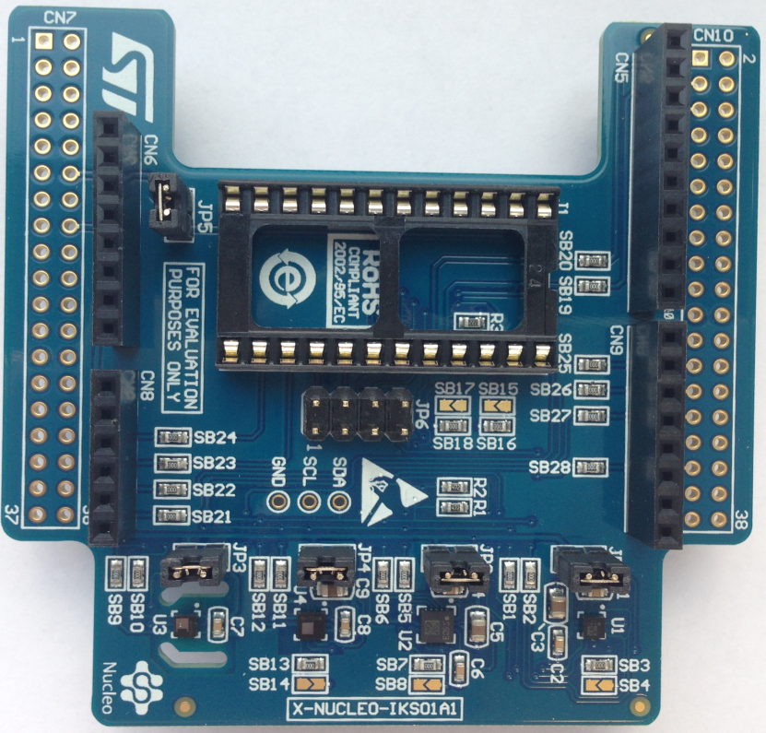
Motion MEMS and environmental sensors expansion board (X-NUCLEO-IKS01A1) Hardware Overview (2/3)
X-NUCLEO-IKS01A1 Hardware Description
The X-NUCLEO-IKS01A1 is a motion MEMS and environmental sensor evaluation board.
It is compatible with the Arduino UNO R3 connectors layout, and is designed around ST’s latest sensors.
Key Product on board
LSM6DS0: MEMS 3D accelerometer (±2/±4/±8 g) + 3D gyroscope (±245/±500/±2000 dps)
LIS3MDL: MEMS 3D magnetometer (±4/ ±8/ ±12/ 16 gauss)
LPS25HB: MEMS pressure sensor, 260-1260 hPa absolute digital output barometer
HTS221: capacitive digital relative humidity and temperature
DIL 24-pin: socket available for additional MEMS adapters and other sensors (UV index)
HTS221
LSM6DS0
ST morpho connector**
LPS25HB
LIS3MDL
Arduino UNO R3 connector
Latest info available at
X-NUCLEO-IKS01A1
DIL 24-pin
Order code: X-NUCLEO-IKS01A1
** Connector for the STM32 Nucleo Board

Slide 10
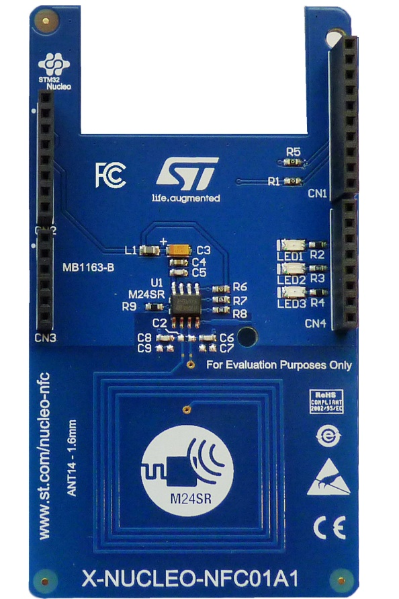
NFC expansion board (X-NUCLEO-NFC01A1) Hardware Overview (3/3)
X-NUCLEO-NFC01A1 Hardware Description
The X-NUCLEO-NFC01A1 is a Dynamic NFC tag evaluation board designed around the M24SR64-Y that allows expansion of the STM32 Nucleo boards.
The M24SR64-Y communicates with STM32 Nucleo developer board though an I2C link available on the Arduino UNO R3 connector
Key Products on board
M24SR: This device is dynamic NFC/RFID tag IC with a dual interface. It embeds a 64 Kbit EEPROM memory. It can be operated from an I2C interface or by a 13.56 MHz RFID reader or a NFC Smartphone.
NFC antenna: 31 mm x 30 mm 13.56 MHz double layer inductive antenna etched on the PCB (ANT14)
Printed Antenna
M24SR
Arduino UNO R3 connector
Latest info available at X-NUCLEO-NFC01A1
Order code: X-NUCLEO-NFC01A1

Slide 11
FP-CLD-BLUEMIX1 Software Overview
FP-CLD-BLUEMIX1 Software Description
FP-CLD-BLUEMIX1 is an expansion software package for STM32Cube for portability across different STM32 microcontrollers. The software runs on the STM32 microcontroller and includes drivers for the SPWF01SA Serial-to-Wi-Fi module, HTS221, LPS25HB, LSM6DS0, LIS3MDL sensors, and M24SR64-Y dynamic NFC/RFID tag. It also includes a middleware package implementing the MQTT protocol over TLS 1.2 is used as application protocol to facilitate interaction between the STM32 Nucleo boards and Cloud services and securing data. The software includes examples for visualizing sensor data and controlling the device via IBM Bluemix® Cloud service.
Key features
Complete middleware to build applications based on Wi-Fi connectivity (SPW01SA) and to connect STM32 Nucleo boards with Cloud based services
Software interface to access temperature and humidity sensor (HTS221), pressure sensor (LPS25HB), motion sensors (LIS3MDL and LSM6DS0) and to write and read the RFID/NFC tag (M24SR64-Y)
Integrated MQTT protocol middleware
Sample implementation available on board X-NUCLEO-IKS01A1, X-NUCLEO-IDW01M1, and X-NUCLEO-NFC01A1, when both connected to NUCLEO-F401RE
Easy access to IBM Bluemix® Cloud services for sensors data visualization and processing
Easy portability across different MCU families, thanks to STM32Cube
Free, user-friendly license terms
Overall Software Architecture
IBM Bluemix Application
Utilities
Applications
NFC Middleware
Wi-Fi Middleware
MQTT
CMSIS
Middleware
Hardware Abstraction Layer API
Boards Support Packages
Drivers
STM32
SPWF01SA
M24SR64
HTS221
LPS25HB
LSM6DS0
LIS3MDL
HW Components
STM32 Nucleo Board
X-NUCLEO-IDW01M1
Expansion Board
X-NUCLEO-IKS01A1
Expansion Board
X-NUCLEO-NFC01A1
Expansion Board
Development boards
FP-CLD-BLUEMIX1
Latest SW available at
For IBM Bluemix package: www.st.com/web/catalog/tools/FM147/CL1794/SC961/SS1743/LN1992/PF263214
Notes:
MQTT: MQ Telemetry Transport

Slide 12
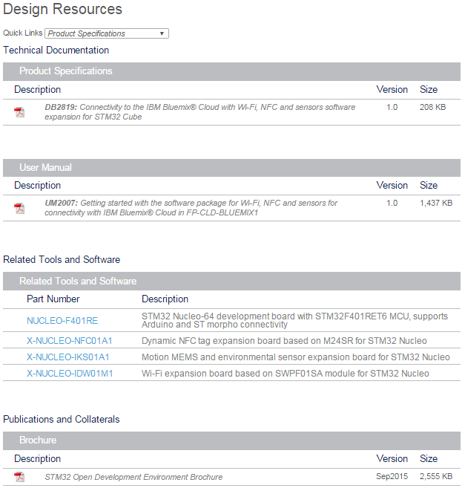
Documents & Related Resources
All documents are available in the Design Resources tab of
the FP-CLD-BLUEMIX1 Webpage
FP-CLD-BLUEMIX1: Product Folder (Link)
DB2819: Connectivity to the IBM Bluemix® Cloud with Wi-Fi, NFC and sensors software expansion for STM32 Cube – data brief
UM2007: Getting started with the software package for Wi-Fi, NFC and sensors for connectivity with IBM Bluemix® Cloud in FP-CLD-BLUEMIX1 – user manual
X-NUCLEO-IDW01M1: Product Folder (Link)
Gerber files, BOM, Schematic
DB2726: Wi-Fi expansion board based on SPWF01SA module for STM32 Nucleo – data brief
UM1975: Getting started with X-NUCLEO-IDW01M1 Wi-Fi expansion board based on SPWF01SA module for STM32 Nucleo – user manual
X-NUCLEO-IKS01A1: Product Folder (Link)
Gerber files, BOM, Schematic
DS10619: Motion MEMS and environmental sensor expansion board for STM32 Nucleo – data brief
UM1820: Getting started with motion MEMS and environmental sensor expansion board for STM32 Nucleo – user manual
X-NUCLEO-NFC01A1: Product Folder (Link)
Gerber files, BOM, Schematic
DB2353: Dynamic NFC tag expansion board based on M24SR for STM32 Nucleo – data brief
AN4624: Getting started with the STM32 Nucleo and the M24SR expansion board X-NUCLEO-NFC01A1 – application note
UM1793: Dynamic NFC tag expansion board based on M24SR for STM32 Nucleo – user manual

Slide 13

Hands on Agenda
3
Lab 1: HW and SW setup
Lab 2: Set the SPWF variables
Lab 2a: FOTA update
Lab 3: Access point connection (WPA or WEP)
Lab 4: Web client mode
Lab 5: Web server mode – files in RAM
Lab 6: Web server mode – files in FLASH
Lab 7: Socket interface
Lab 8: MiniAP mode for the first set
Lab 9: Socket interface in MiniAP mode
Lab 10: Web server in MiniAP mode
Lab 11: Remote control of GPIO interfaces
Lab 12: Input demo
Lab 13: Socket Server
Lab 14: Low Power Modes
Lab 15: HW switch from STA to MiniAP
Lab 16: IBSS mode
Lab 17: BlueMIX

Slide 14

Lab 1: HW and SW setup
4
Objective
Hardware set-up
Software set-up
Prerequisites
Work alone

Slide 15

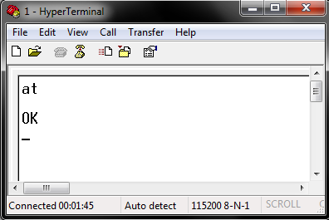
Lab 1: EVAL of the SPWF01SA.11 module
5
Plug&Play Solution
AT command set
Power Supplied via the USB interface
UART/USB bridge from Silicon Lab requires to install the correspondent driver on your PC
SMD antenna and reset button on-board
HyperTerminal or similar
AT Commands/Events
VCOM
SWPF01SA
ST Morpho connector**
Arduino UNO R3 connector

Slide 16
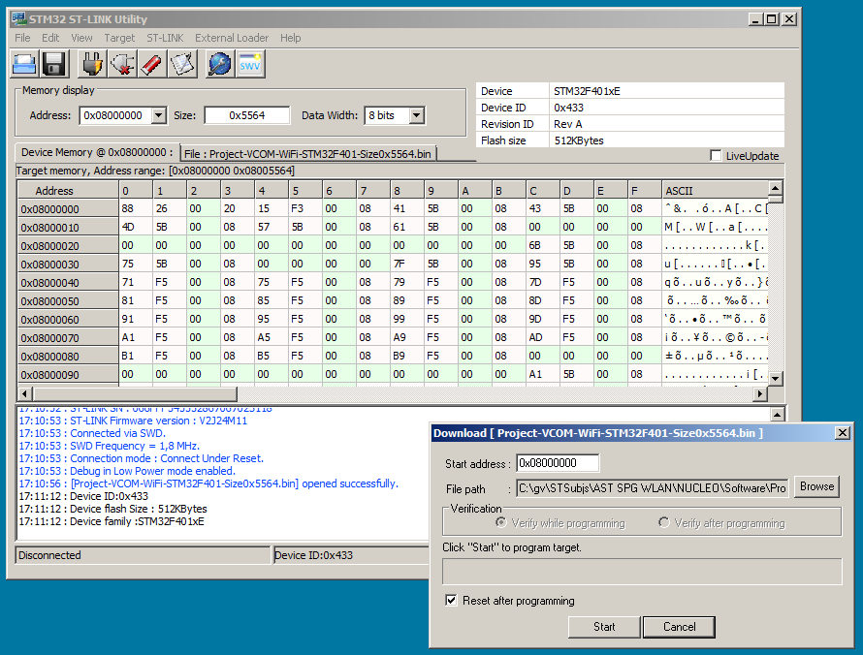
Tutorial #1a: Loading the VCOM driver
Run STM32-Link Utility.
Select “Target” + “Connect”.
Select “Program…”
“Start Address” is 0x08000000.
Select “Project-VCOM-WiFi-STM32F401.bin” in the “NUCLEO-STM32F401 Binaries” subdirectory using “Browse” button.
Click “Start”

Slide 17
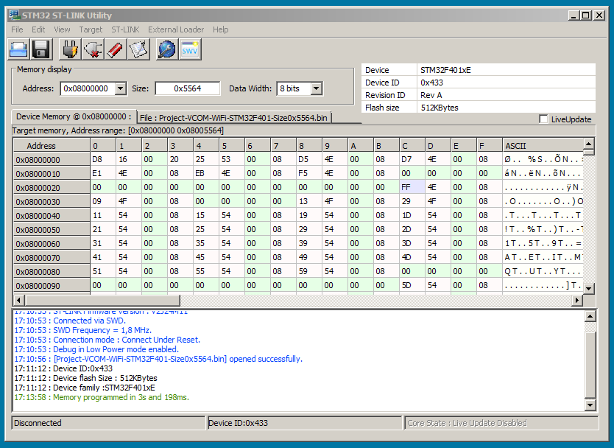
Tutorial #1a: Loading the VCOM driver
Wait for green “Memory programmed…” message.
Select “Target” + “Disconnect”
Done!
Using Teraterm, on the PC, we will now access the SPWF01S module directly over the UART.

Slide 18
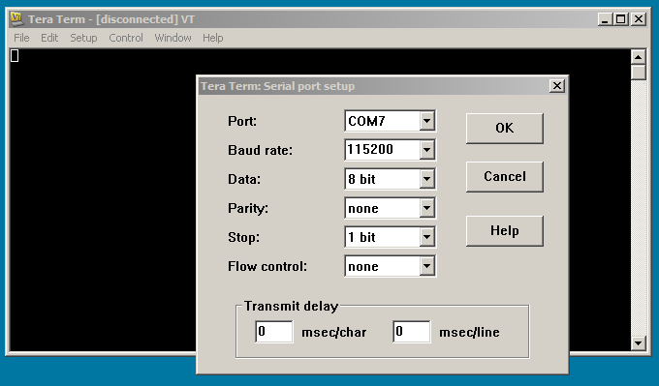
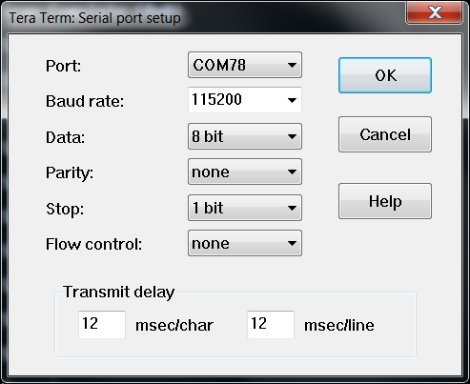
Tutorial #1a: Configuring TeraTerm
Run TeraTerm.
Select “Setup” + “Serial Port…”
Set “Port: to the last COM port.
Set “Baud rate” to “115200”.
Add the delay
Click “OK”.

Slide 19
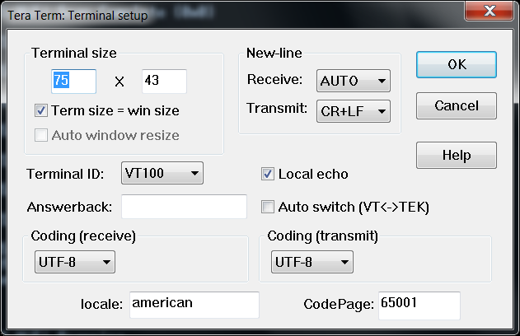
Tutorial #1b: Configuring TeraTerm
Configure the Tera Term New-line to receive in AUTO and to Transmit with CR+LF

Slide 21
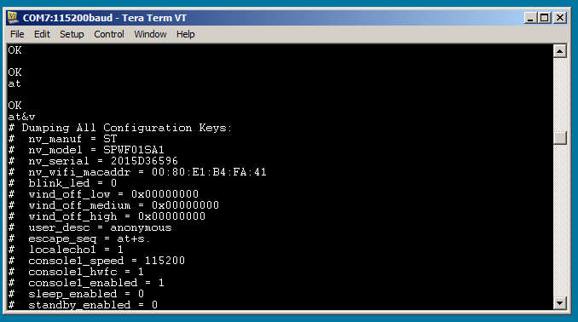
Tutorial #1c: Configure the module to echo
Enter: “at”<cr>.
To enable character echo, enter: “at+s.scfg=localecho1,1”<cr>
Enter: “at”<cr>.
Enter: “at&v”<cr>.

Slide 22
Lab 1: Configuring the UART
10
Open Tera Term
Command Mode
Type AT followed by a carriage return (CR)
Tera Term output
All
OK

Slide 23
You are ready to use your Wifi
EVAL board!

Slide 24

Lab 2: Set the SPWF variables
12
Objective
Run a command
Get the default configuration dump
Set host name
Set static IP parameters
Reset the module
Prerequisites
Work alone

Slide 25
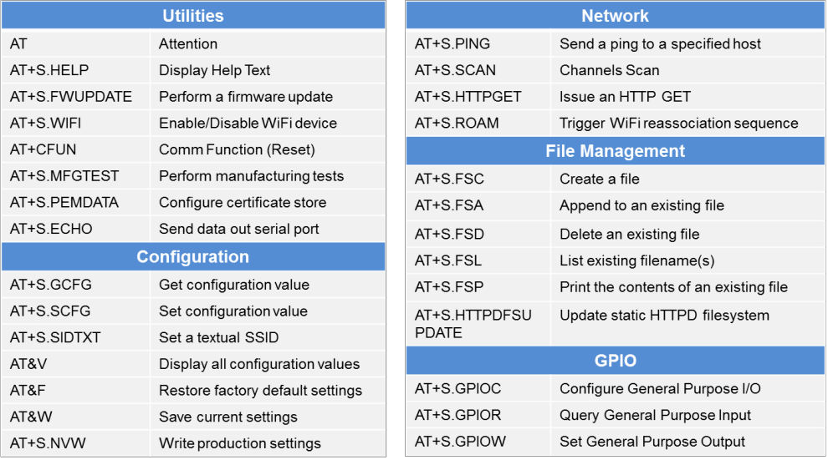
Lab 2: Run a command
13
Run a command - Syntax
AT&x <CR>
AT+S.[Command] <CR>
AT Command Prefix
Not case sensitive
Response - Syntax
xxxxxxxx
OK
Command output followed by OK
ERROR: Command not found
ERROR: Unrecognized key

Slide 26
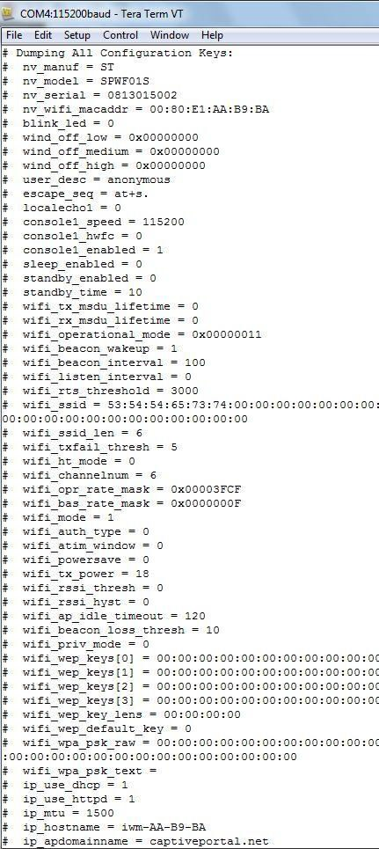
Lab 2: Set the SPWF variables
14
Get the default configuration dump
Type AT&V
Get a variable value
Type AT+S.GCFG=console1_speed
Config dump frame
Variable Name
Variable Value
How to change the variable value?
AT+S.SCFG=[var name],xxxx
AT&W

Slide 27
Lab 2: Set the SPWF variables
15
Get the default configuration dump
Set host name
Type AT+S.SCFG=ip_hostname,xxxxxxxx
Tera Term output
Up to 31 characters (case sensitive),
͞spaĐeďar͟ is allowed
All
OK

Slide 28
Lab 2: Set the SPWF variables
16
Get the default configuration dump
Set host name
Set IP address, IP default gateway, IP DNS and IP netmask (for static usage)
Type AT+S.SCFG=ip_ipaddr,192.168.0.1xx
• Type AT+S.SCFG=ip_gw,192.168.0.1
Type AT+S.SCFG=ip_dns,192.168.0.1
Type AT+S.SCFG=ip_netmask,255.255.255.0
Tera Term output
All
OK

Slide 29
Lab 2: Set the SPWF variables
17
Get the default configuration dump
Set host name
Set IP address, IP default gateway, IP DNS and IP netmask (DHCP off)
Save settings on the flash memory (mandatory after a variable change)
Type AT&W
Tera Term output
Reset the module
Type AT+CFUN=1
All
+WIND:21:WiFi Scanning +WIND:35:WiFi Scan Complete (0x0)

Slide 30
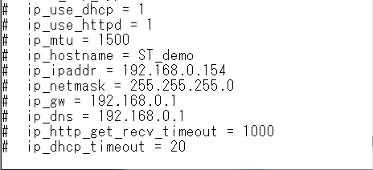
Lab 2: Set the SPWF variables
18
Get the default configuration dump
Set host name
Set IP address, IP default gateway, IP DNS and IP netmask (DHCP off)
Save settings on the flash memory (mandatory after a variable change) and reset the module
Check the new configuration dump
Type AT&V

Slide 31
Proceed to the next LAB!

Slide 32


Lab 2a: FOTA update
20
Objective
Upgrade the FW using the OTA file
Prerequisites
OTA file (provided in the SPWF01S FW
package)
External web server (i.e. Apache web server running on PC)

Slide 33
Lab 2a: FOTA update
21
The SPWF01Sx.11 module (with external flash on board) allows performing a Firmware Over-the-air update via a single HTTP GET.
The SPWF01S will validate the firmware image it downloads, load it into a staging area, then prompt the user to issue a reset command in order to complete the update.

Slide 34

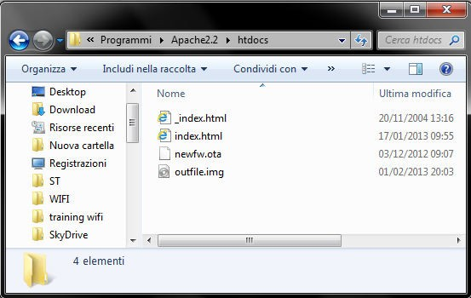
Lab 2a: FOTA update
22
The Apache Web Server will be used in this LAB
(Apache Web Server is available at this link: http://archive.apache.org/dist/httpd/binaries/win32/httpd-2.2.25-win32-x86-openssl-0.9.8y.msi)
Note: please check that the local firewall is disabled or properly set. It can block the connection from module to Apache.
Copy the OTA file (i.e. SPWF01S-xxxxxx-yyyyyyy- RELEASE-main.ota) in the Apache 2.2 htdocs folder

Slide 35
Lab 2a: FOTA update
23
The FWUPDATE command allows to perform a Firmware Over-the- air update via a single HTTP GET.
Sintax
AT+S.FWUPDATE=<hostname>,<path>,<port>
Configuration parameters
<hostname>
Target host. DNS resolvable name or IP address
<path&queryopts>
<port>
Document path and optional query arguments
Target host port

Slide 36
Lab 2a: FOTA update
24
The module and the Apache Web server must be connected to the same network
In Tera Term: type AT+S.FWUPDATE=[Apache IP address],/[ota_file.ota]
i.e. type AT+S.FWUPDATE=192.168.x.yyy,/SPWF01S-150410-c2e37a3-RELEASE-
main.ota
Tera Term output
All
Staging F/W update for 'SPWF01SX.11' version '1203- 120918_01' F/W length 276824 @ 0x00002800 (offset 0x00000000, block len 4096) Write len 4096 -> 0x0 Write len 4096 -> 0x1000 (note - deleted extra output for clarity) Write len 4096 -> 0x42000 Write len 2476 -> 0x43000 (final) Wrote 276904 bytes Complete! Update will be applied on next reboot. (at+cfun=1)
Reset the module to apply the new FW
Type AT+CFUN=1
Restore factory default settings (mandatory)
Type AT&F

Slide 37
Proceed to the next LAB!

Slide 38

Lab 3: Access point connection
26
Objective
Scan for available networks
Join a network
Check the status/statistics variables
Prerequisites
USB dongle and computer are set up as described in Lab 2
Work alone

Slide 39
Lab 3: Scan for available networks
27
The SCAN command performs an immediate scan for available networks. Infrastructure (AP) and IBSS (Ad-Hoc) networks are both reported. Network type, Channel, BSSID, SSID, Signal strength (RSSI), and 802.11 capabilities are all reported.
Type AT+S.SCAN
(AT+S.SCAN=a,r to perform a non-filtered scan)
Tera Term output
All
FOUND: BSS 14:D6:4D:24:36:00 CHAN: 01 RSSI: -28 SSID: 'ENG-WPA' CAPS: 0431 WPA WPA2 FOUND: BSS 00:18:0A:31:EA:78 CHAN: 11 RSSI: -82 SSID: 'ZyckoItalyWireless' CAPS: 0531 WPA WPA2 FOUND: BSS 06:18:0A:31:E7:E2 CHAN: 11 RSSI: -85 SSID: 'ZyckoItalyGuest' CAPS: 0531 WPA WPA2
OK
Network type
Network SSID
Network capabilities
Network channel
Network RSSI
Network MAC

Slide 40
Lab 3: Joining a network (WPA Key)
28
In order to be connected to an available Wifi network, the AP parameters setting is needed.
Set the SSID
Type AT+S.SSIDTXT=ST_OFFICE
Set the password
Type AT+S.SCFG=wifi_wpa_psk_text,stbrasil2016
Set the network privacy mode (0=none, 1=WEP, 2=WPA-Personal (TKIP/AES) or WPA2-Personal (TKIP/AES))
Type AT+S.SCFG=wifi_priv_mode,2
Set the network mode (1 = STA, 2 = IBSS, 3 = MiniAP)
Type AT+S.SCFG=wifi_mode,1
Tera Term output
All
OK

Slide 41
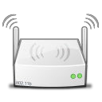

Lab 3: Joining a network (WPA Key)
29
Save the settings on the flash memory and reset the module
Type AT&W
Type AT+CFUN=1
Tera Term output
All
+WIND:0:Console active +WIND:46:WPA: Crunching PSK... +WIND:32:WiFi Hardware Started +WIND:21:WiFi Scanning +WIND:35:WiFi Scan Complete (0x0) +WIND:19:WiFi Join: 14:D6:4D:24:36:00 +WIND:25:WiFi Association with 'ENG-WPA' successful +WIND:51:WPA Handshake Complete +WIND:24:WiFi Up: 192.168.0.1xx
AP
ENG-WPA

Slide 42
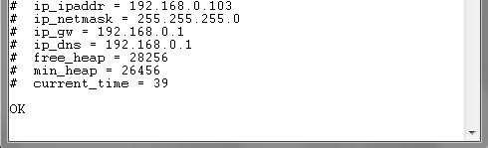
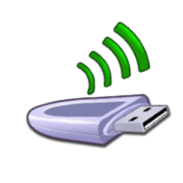
Lab 3: Joining a network (WPA Key)
30
Check the status/statistics variables
Type AT+S.STS
Send a ping to the gateway (ip_gw)
• Type AT+S.PING=192.168.0.1
Tera Term output
All
OK
AP
ENG-WPA

Slide 43
Lab 3: Joining a network (WEP Key)
31
Configure the module using the WEP key (4 possible combinations
available)
Sample table:
AP configuration | AT command to be used
Security Mode: WEP WEP Key Length: 64 bit (10 hex digits) Authentication: Open Wep Key 1: 1234567890 | i.e. at+s.ssidtxt=ENG-WEP AT+S.SCFG=wifi_wep_keys[0],1234567890 AT+S.SCFG=wifi_wep_key_lens,05 AT+S.SCFG=wifi_auth_type,0 AT+S.SCFG=wifi_priv_mode,1 AT+S.SCFG=wifi_mode,1 at&w at+cfun=1
Security Mode: WEP WEP Key Length: 64 bit (10 hex digits) Authentication: Shared Key Wep Key 1: 1234567890 | i.e. at+s.ssidtxt=ENG-WEP AT+S.SCFG=wifi_wep_keys[0],1234567890 AT+S.SCFG=wifi_wep_key_lens,05 AT+S.SCFG=wifi_auth_type,1 AT+S.SCFG=wifi_priv_mode,1 AT+S.SCFG=wifi_mode,1 at&w at+cfun=1
AP configuration | AT command to be used
Security Mode: WEP WEP Key Length: 128 bit (26 hex digits) Authentication: Open Wep Key 1: 123456789012345678 90123456 | i.e. at+s.ssidtxt=ENG-WEP AT+S.SCFG=wifi_wep_keys[0],12345678 901234567890123456 AT+S.SCFG=wifi_wep_key_lens,0D AT+S.SCFG=wifi_auth_type,0 AT+S.SCFG=wifi_priv_mode,1 AT+S.SCFG=wifi_mode,1 at&w at+cfun=1
Security Mode: WEP WEP Key Length: 128 bit (26 hex digits) Authentication: Shared Key Wep Key 1: 123456789012345678 90123456 | i.e. at+s.ssidtxt=ENG-WEP AT+S.SCFG=wifi_wep_keys[0],12345678 901234567890123456 AT+S.SCFG=wifi_wep_key_lens,0D AT+S.SCFG=wifi_auth_type,1 AT+S.SCFG=wifi_priv_mode,1 AT+S.SCFG=wifi_mode,1 at&w at+cfun=1

Slide 44
Lab 3: Joining a network (WEP Key)
32
Notes:
“wifi_wep_key_lens” variable values: 05 and 0D
It’s possible to enter any text string into a WEP key box in the AP, in which case it will be converted into a hexadecimal key using the ASCII values of the characters. A maximum of 5 text characters can be entered for 64 bit keys, and a maximum of 13 characters for 128 bit keys.
In this case, it needs to manually convert your ASCII password to HEX and complete the wifi_wep_keys[0] variable with the HEX value.
i.e.
AP WEP key: test1
ASCII to HEX: 74:65:73:74:31
So, the AT command is: AT+S.SCFG=wifi_wep_keys[0],7465737431

Slide 45
Proceed to the next LAB!

Slide 46


Lab 4: Web client mode
34
Objective
HTTP GET
HTTP POST
PUSH DATA ON SERIAL PORT
Prerequisites
USB dongle and computer are set up as described in Lab 2
Work in couple

Slide 47
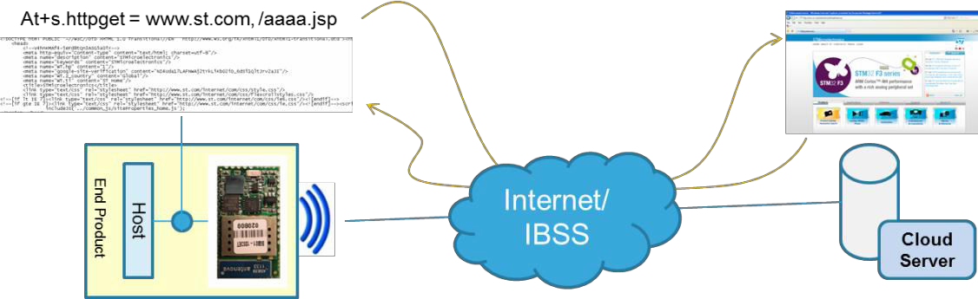
Lab 4: HTTP GET
35
The HTTP GET feature performs a single HTTP request to the specified
host and path. The server response is printed on the UART enabled.
Sintax
AT+S.HTTPGET=<hostname>,<path>[,<port>]
Configuration parameters
<hostname>: target host. DNS resolvable name or IP address
<path>: document path
<port>: target port

Slide 48
Lab 4: HTTP GET
36
Device A performs an HTTP GET to the Device B
Device A:
AT+S.HTTPGET=<Device B IP addr>,/index.html Type AT+S.HTTPGET=192.168.0.1xx,/index.html
Tera Term output
Device A
GET /index.html HTTP/1.0 User-Agent: SPWF01S
………..
<h1>ST SPWF01Sx.11 WiFi Module</h1>
<p>
Welcome to the ST SPWF01Sx.11 WiFi Module.
</p>
<p>
This page was delivered from the SPWF01Sx.11 internal HTTP server.
…..
<a href=/status.shtml>SPWF01Sx.11 Status Page</a>
</p>
</body>
</html>
A
B
OK

Slide 49
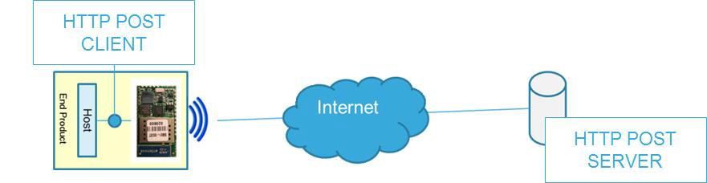
Lab 4: HTTP POST
37
The HTTP POST performs a post of the given path to the specified host.
The module can be only used as an HTTP POST client.
Sintax
AT+S.HTTPPOST =<hostname>,<path&queryopts>,<formcontent>[,<port>]
Configuration parameters
<hostname>: target host. DNS resolvable name or IP address
<path&queryopts>: document path
<formcontent>: form to be submitted
<port>: target port

Slide 50



Lab 4: HTTP POST
38
The SPWF01S performs an HTTP POST to an HTTP Post Test Server
Type: at+s.httppost=posttestserver.com,/post.php,name=demo&email=mymail&subjec t=subj&body=message
The HTTP Post Test Server replies as displayed in the Tera Term output if the HTTP POST successfully
Tera Term output
Device A
HTTP/1.1 200 OK Date: Fri, 10 Jan 2014 13:24:14 GMT Server: Apache Access-Control-Allow-Origin: * Vary: Accept-Encoding Content-Length: 139 Connection: close Content-Type: text/html Successfully dumped 4 post variables. View it at http://www.posttestserver.com/data/2014/01/10/0 5.24.1443192628 Post body was 0 chars long. OK
HTTP POST SERVER
A
B

Slide 51
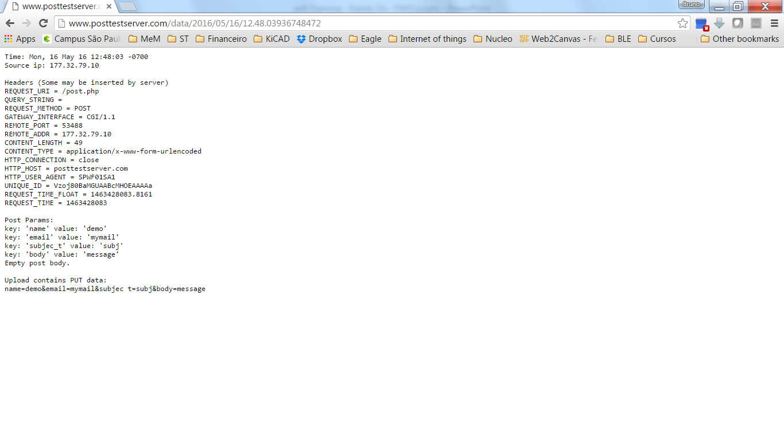
Lab 4: HTTP POST
38

Slide 52
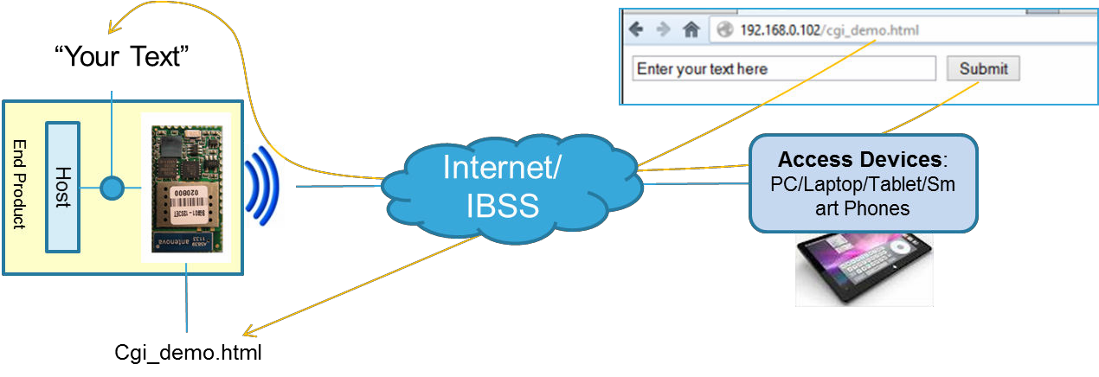
Lab 4: Push data on serial port
39
A built-in html page “output_demo.html” allows to remotely push
characters on the serial port from a remote browser.
Module’s IP address/output_demo.html
output_demo.html

Slide 53
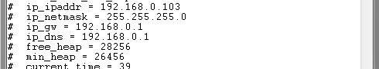
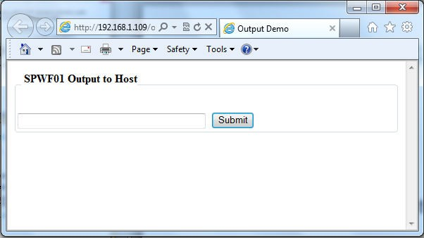
Lab 4: Push data on serial port
40
Find your IP address
Type AT+S.STS
Associate your computer with the AP
Open your web browser
In the address bar, type
<module’s IP
Address>/output_demo.html
Type 192.168.0.1xx/output_demo.html

Slide 54
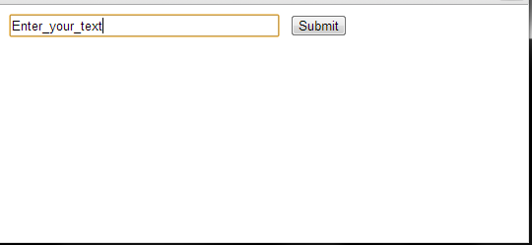
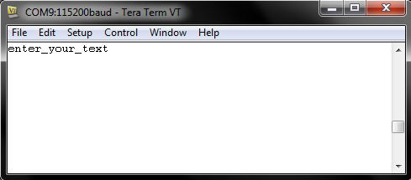
Lab 4: Push data on serial port
41
Enter the text
Submit
The text will be sent to the serial port of the module

Slide 55
Proceed to the next LAB!

Slide 56

Lab 5: Web Server use mode
43
Objective
List existing files
Print a file
Create a file
Append to an existing file
Delete an existing file
Prerequisites
USB dongle and computer are set up as described in Lab 2
Work alone

Slide 57
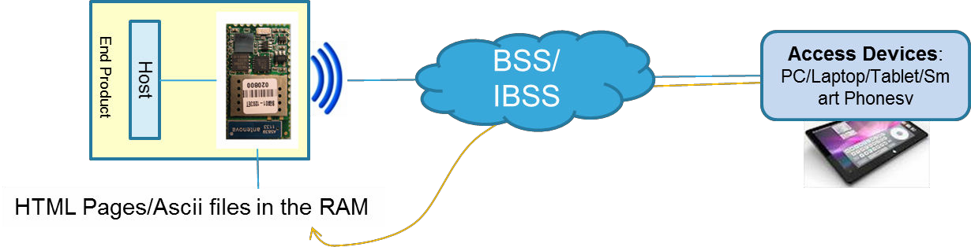
Lab 5: Web server
44
The Web Server feature allows to create, print and delete ASCII files in the RAM memory of the module.

Slide 58
Lab 5: List existing files
45
The FSL command lists type, sizes and name of all the existing files.
Type AT+S.FSL
Tera Term output
All
I 461 /input_demo.shtml
I 180 /message.shtml
I 384 /output_demo.html
I 614 /index.html
I 157 /peers.shtml
I 193 /config.shtml
I 174 /status.shtml
I 212 /404.html
I 2022 /firstset.html
I 2898 /remote.html
Files stored in the STM32 FLASH memory
OK

Slide 59
Lab 5: Print a file
46
The FSP command prints the content
of an existing file.
Type AT+S.FSP=/index.html
Tera Term output
All
<html> <head><title>ST SPWF01S</title></head> <body bgcolor="white" text="black"> <h1>ST SPWF01S Intelligent WiFi Module</h1> <p>Welcome to the ST SPWF01S intelligent Wi-Fi module.</p> <p>This page was delivered from the SPWF01S internal HTTP server.</p> <p> <a href=/config.shtml>SPWF01S Configuration Settings Page</a> </p> <p> <a href=/status.shtml>SPWF01S Status Page</a> </p> <p> <a href=/peers.shtml>SPWF01S Peers Page</a> </p> <p>More information about the SPWF01S and other ST products can be found at ST's website: <a href="http://www.ST.com/">http://www.ST.com/</a>.</p> </body> </html> OK
Tip: How to use the offset and length parameters: AT+S.FSP=/index.html,[offset],[length]
i.e. Type AT+S.FSP=/index.html,5,20
Length parameter is mandatory if is used the offset.

Slide 60
Lab 5: Create a file
47
The FSC command allows to create a file inside the SPWF for
delivery by the SPWF HTTP server.
Sintax
AT+S.FSC =<fname>,<max_len>[,<http_header>]
Configuration parameters
< filename >: filename to create
< max_len >: amount of space to allocate for file, max = 4096 bytes
<http_header>: 0=HTML header automatically added, 1=HTML header not added (as by default)
Tera Term output
Type AT+S.FSC=/wifidemo.html,1965
All
OK

Slide 61
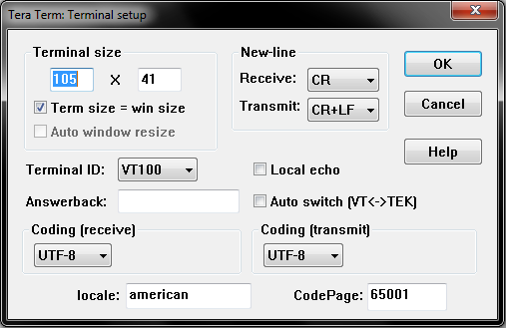
Lab 5: Configuring the UART
48
Set CR+LF in the Terminal setup (to properly paste text in the terminal):
Tera Term: Setup → Terminal →
Transmit: CR+LF

Slide 62
Lab 5: Append to an existing file
49
The FSA command allows to append blocks of data to an existing file.
This command accepts data after the <cr> at the end of the command
line.
Sintax
AT+S.FSA=/<filename>,<datalen>
Configuration parameters
< filename >: filename pre-created
< datalen >: number of characters to append to the file
Type AT+S.FSA=/wifidemo.html,1965
Tips
Now SPWF accepts data

Slide 63
Lab 5: Append to an existing file
50
Open wifidemo.txt in the following directory: Hands_on folder/HTML_demo_page
Copy the file content into Tera term (paste with ALT+V or mouse right button)
Tera Term output
All
OK

Slide 64
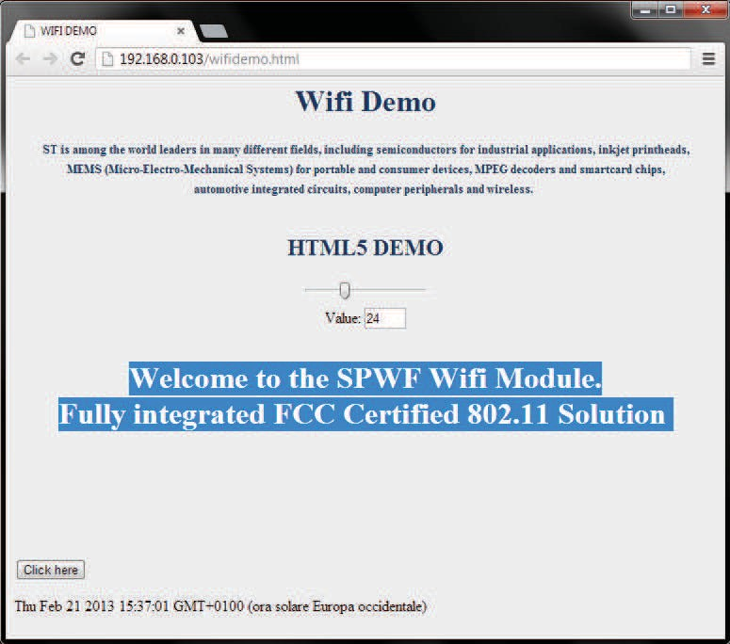
Lab 5: Append to an existing file
51
Open wifidemo.html
Open your Web browser (suggested Google
Chrome for HTML5 test)
In address bar, type <SPWF IP addr>/wifidemo.html Type 192.168.0.1xx/wifidemo.html

Slide 65
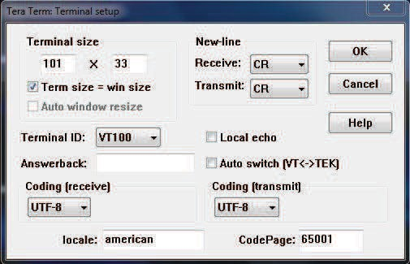
Lab 5: Configuring the UART
52
Re-set CR in the Terminal setup
as by default
Tera Term: Setup → Terminal →
Transmit: CR

Slide 66
Lab 5: List existing files
53
Let's list the files
Type AT+S.FSL
Tera Term output
File stored in the RAM memory
All
D 1965 /wifidemo.html
I 461 /input_demo.shtml
I 180 /message.shtml
I 384 /output_demo.html
I 614 /index.html
I 157 /peers.shtml
I 193 /config.shtml
I 174 /status.shtml
I 212 /404.html
I 2022 /firstset.html
I 2898 /remote.html
OK

Slide 67
Lab 5: Delete an existing file
54
The FSD command allows to delete an existing file by name. Static
files may not be deleted.
Sintax
AT+S.FSD=/<filename>
Type AT+S.FSD=/wifidemo.html
Tera Term output
All
OK

Slide 68
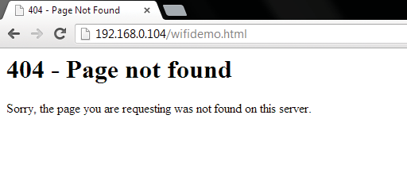
Lab 5: Delete an existing file
55
Re-open wifidemo.html
Open your Web browser
In address bar: <SPWF IP addr>/wifidemo.html Type 192.168.0.1xx/wifidemo.html

Slide 69
Proceed to the next LAB!

Slide 70

Lab 6: Web Server use mode
57
Objective
Create an image file
Filesystem update over-the-air
Prerequisites
Work alone

Slide 71
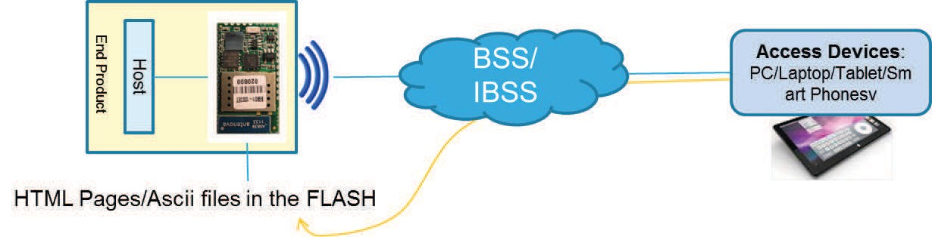
Lab 6: Web server
58
The Web Server feature also allows to upload generic files (PDF, HTML, DOC, JPEG and so on) in the EXTERNAL FLASH memory of the module. It needs to follow the below steps:
create an image file (IMG) using the tool provided in the Hands-on package (the IMG contains the files to upload)
Put the image in a generic and accessible Web Server (Apache Web server
will be used in the Hands-on as example)
Using the proper AT command, the IMG will be retrieved over-the-air and the static files will be created in the external flash memory

Slide 72
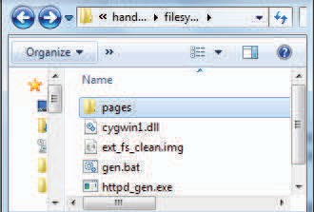
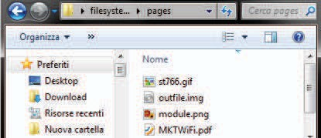
Lab 6: Create an image file
59
Open the following folder and
extract all the files:
../hands_on_wifi/filesystem_update
Put your own files to upload in the
pages folder (max 512 Kbytes)
Run gen.bat
1 2
Open the pages folder and copy outfile.img in your external Web Server (Apache)
3

Slide 73

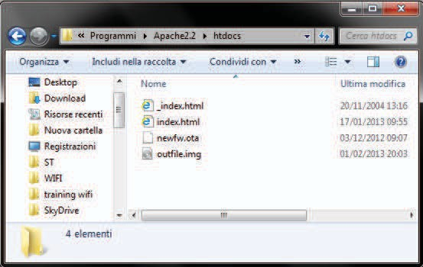
Lab 6: Create an image file
60
The Apache Web Server will be used in this tutorial
(Apache Web Server is available at this link: http://archive.apache.org/dist/httpd/binaries/win32/httpd-2.2.25-win32-x86-openssl-0.9.8y.msi)
Note: please check that the local firewall is disabled or properly set. It can block the connection from module to Apache.
Copy outfile.img in the Apache 2.2
htdocs folder (this is the default root server directory)
4

Slide 74
Lab 6: Filesystem update
61
The HTTPDFSUPDATE command allows to create static files inside the SPWF for delivery by the SPWF HTTP server.
Sintax
AT+S.HTTPDFSUPDATE=<hostname>,<path>[,port]
Configuration parameters
<hostname>: external web server. DNS resolvable name or IP address
<path>: document path
<port>: target host port

Slide 75
Lab 6: Filesystem update
62
In Tera Term: type
AT+S.HTTPDFSUPDATE=192.168.x.10x,/outfile.img
Tera Term output
All
Image length 357957 (offset 0x00080000, block len 4096)
Write len 4096 -> 0x80000
Write len 4096 -> 0x81000
Write len 4096 -> 0x82000
…………..
………………
……………
Write len 4096 -> 0xD6000
Write len 1612 -> 0xD7000 (final)
Wrote 357964 bytes
Complete! Please reboot. (at+cfun=1)
OK
Warning
The file system will be permanently deleted.
The new IMG will overwrite the existent files in the file system
Reset the module
Type AT+CFUN=1

Slide 76
Lab 6: Filesystem update
63
Let's list the files
Type AT+S.FSL
Tera Term output
All
 | E 2615 /st766.gif E 112374 /module.png E 2430 /index1.html E 419 /index.html E 239887 /MKTWiFi.pdf I 461 /input_demo.shtml I 180 /message.shtml I 384 /output_demo.html I 614 /index.html I 157 /peers.shtml I 193 /config.shtml I 174 /status.shtml I 212 /404.html I 2022 /firstset.html I 2898 /remote.html OK
Files stored in the EXT FLASH
memory

Slide 77
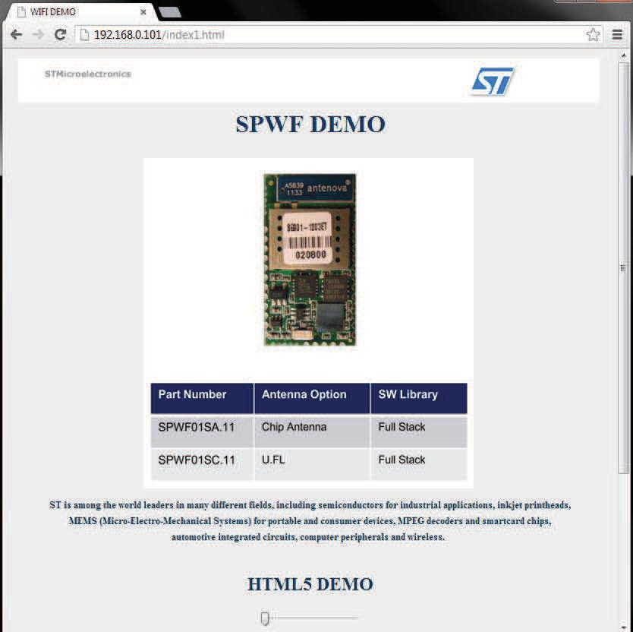
Lab 6: Filesystem update
64
Open index1.html page
Open your web browser
In the address bar: <SPWF IP addr>/index1.html Type 192.168.x.1xx/index1.html

Slide 78
Lab 6: Filesystem erase
65
Erase the external httpd filesystem
Type AT+S. HTTPDFSERASE
The files stored in the EXT FLASH memory will be erased
Tera Term output
Let's list the files
Type AT+S.FSL
All
I 461 /input_demo.shtml I 180 /message.shtml I 384 /output_demo.html I 614 /index.html I 157 /peers.shtml I 193 /config.shtml I 174 /status.shtml I 212 /404.html I 2022 /firstset.html I 2898 /remote.html OK

Slide 79
Proceed to the next LAB!

Slide 80


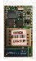


Lab 7: Socket interface
67
Objective
Open TCP/UDP connection
Write data to socket
Read data from socket
Close socket
Prerequisites
Work alone
Socket Server
Socket Client
TCP/UDP socket

Slide 81

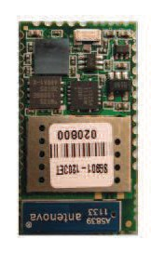

Lab 7: TCP/UDP/UART socket interface
68
The Socket interface allows communication via TCP, UDP and UART. The SPWF is both a client and a server socket. In this LAB, will be detailed the socket client feature.
Host
End Product
Open TCP/UDP connection
Write data to socket
Read data from socket
Close socket

Slide 82
Lab 7: Open TCP/UDP connection
69
The SOCKON command allows to open a TCP/UDP connection
to a specified host (up to 8 socket connections at same time).
Sintax
AT+S.SOCKON=<hostname>,<port>,<protocol>,ind
Configuration parameters
<hostname>: target host. DNS resolvable name or IP address
<port>: TCP/UDP socket port
<protocol>: t for TCP socket, u for UDP socket
ind: indicate when data has arrived (optional). Up to 4 (x730 bytes) consecutive “Pending data” message (without any AT+S.SOCKR) are guaranteed. It is suggested to empty the buffer using the AT+S.SOCKR command and to avoid exceeding 4 indications.

Slide 83
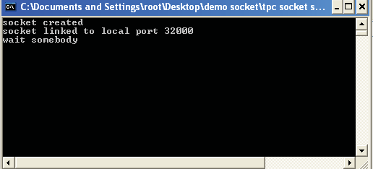
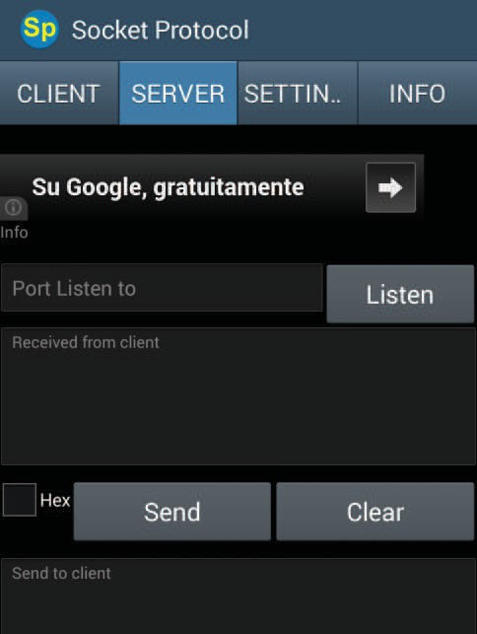
Lab 7: Open TCP/UDP connection
70
Open the TCP socket server (disable the firewall to properly run it)
Folder ../hands_on_wifi/tcp socket server/server.exe
The TCP server listens for incoming connections on the port 32000. It sends back all data received.

Slide 84
Optional - Lab 7: Open TCP/UDP connection
71
Using an Android platform, the socket server can be opened using a specific APP (Socket Protocol, available on Play Store)
The TCP socket server can be configured to listen for
incoming connections on the port 32000.
Type 32000 on «Port Listen to» box
Click on Listen

Slide 85
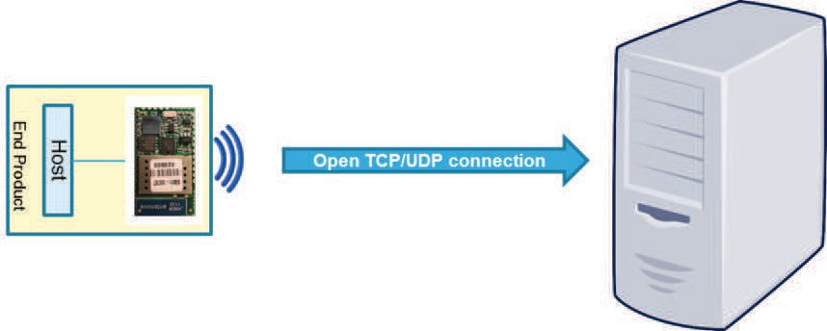
Lab 7: Open TCP/UDP connection
72
• Type AT+S.SOCKON=192.168.0.10x,32000,t,ind
The client and the server use the socket identifier (ID)
displayed
Tera Term output
All
ID: 00 OK

Slide 86
Lab 7: Write data to socket
73
The SOCKW command allows to write data to the specified ID
socket.
This command accepts data after the <cr> at the end of the command line.
Sintax
AT+S.SOCKW=<ID>,<len>
Configuration parameters
<ID>: socket identifier
<len>: data length to send

Slide 87


Lab 7: Write data to socket
74
Write data
Type AT+S.SOCKW=00,13
Note: the module is waiting 13 bytes to be written to the socket. As soon as 13 bytes (or characters) are sent from the terminal, the module is going to write them to the socket and will be ready to receive new commands.
Type hello world<CR>
SPWF shows that there are <pending data> and their amount
Tera Term output
Pending bytes
ID
All
+WIND:55:Pending Data:0:13

Slide 88
Lab 7: Read data from socket
75
The SOCKR command allows to read data from socket.
Sintax
AT+S.SOCKR=<ID>,<len>
Configuration parameters
<ID>: socket identifier
<len>: data length to read

Slide 89


Lab 7: Read data from socket
76
Read data
Type AT+S.SOCKR=00,13
Tera Term output
All
hello world OK

Slide 90
Lab 7: Close socket
77
The SOCKC command allows to close socket.
Sintax
AT+S.SOCKC=<ID>
Configuration parameters
<ID>: socket identifier

Slide 91





Lab 7: Close socket
78
Close socket
Type AT+S.SOCKC=00
Tera Term output
All
OK

Slide 92
Proceed to the next LAB!

Slide 93


Lab 8: MiniAP mode for the first set
80
Objective
Create a direct connection between the module and an end device
First set of the module in order to enable the connection between the module and a generic AP
Prerequisites
Work alone

Slide 94
Lab 8: Configuring the module in MiniAP mode
81
The Mini AP mode is available starting from the following FW release:
SPWF01S-131115-de4568d-RELEASE
In order to set the module in Mini AP mode, the following parameters are needed
Set the SSID
Type AT+S.SSIDTXT=SPWF_AP
Set the network privacy mode (0=OPEN or 1=WEP are supported)
Type AT+S.SCFG=wifi_priv_mode,0
Set the network mode (1 = STA, 2 = IBSS, 3 = MiniAP)
Type AT+S.SCFG=wifi_mode,3
Tera Term output
All
OK

Slide 95





Lab 8: Configuring the module in MiniAP mode
82
Save the settings on the flash memory and reset the module
Type AT&W
Type AT+CFUN=1
Tera Term output
All
+WIND:0:Console active +WIND:32:WiFi Hardware Started +WIND:26:WiFi Started AP +WIND:24:WiFi Up: 172.18.151.1
SPWF_AP

Slide 96
Lab 3: Configuring the module in MiniAP mode (WEP Key)
83
Configure the module using the WEP key (2 possible combinations
available)
Sample table:
AP configuration | AT command to be used
Security Mode: WEP WEP Key Length: 64 bit (10 hex digits) Authentication: Open Wep Key 1: 1234567890 | i.e. at+s.ssidtxt=SPWF_AP AT+S.SCFG=wifi_wep_keys[0],1234567890 AT+S.SCFG=wifi_wep_key_lens,05 AT+S.SCFG=wifi_auth_type,0 AT+S.SCFG=wifi_priv_mode,1 AT+S.SCFG=wifi_mode,3 at&w at+cfun=1
AP configuration | AT command to be used
Security Mode: WEP WEP Key Length: 128 bit (26 hex digits) Authentication: Open Wep Key 1: 123456789012345678 90123456 | i.e. at+s.ssidtxt=SPWF_AP AT+S.SCFG=wifi_wep_keys[0],12345678 901234567890123456 AT+S.SCFG=wifi_wep_key_lens,0D AT+S.SCFG=wifi_auth_type,0 AT+S.SCFG=wifi_priv_mode,1 AT+S.SCFG=wifi_mode,3 at&w at+cfun=1

Slide 97
Lab 3: Configuring the module in MiniAP mode (WEP Key)
84
Notes:
“wifi_wep_key_lens” variable values: 05 and 0D
It’s possible to enter any text string as WEP key. It have to be converted into a hexadecimal key using the ASCII values of the characters. A maximum of 5 text characters can be entered for 64 bit keys, and a maximum of 13 characters for 128 bit keys.
In this case, it needs to manually convert your ASCII password to HEX and complete the wifi_wep_keys[0] variable with the HEX value.
i.e.
WEP key: test1
ASCII to HEX: 74:65:73:74:31
So, the AT command is: AT+S.SCFG=wifi_wep_keys[0],7465737431

Slide 98






Lab 8: Mini AP mode
85
Associate your end device to the SPWF_AP network
Find the SPWF_AP network and connect the end device to the module
Tera Term output
All
+WIND:28:90:18:7C:96:0D:0B Associated +WIND:29:DHCP reply for 172.18.151.2/90:18:7C:96:0D:0B to 172.18.151.2 +WIND:29:DHCP reply for 172.18.151.2/90:18:7C:96:0D:0B to 172.18.151.2
SPWF_AP

Slide 99






Lab 8: Mini AP mode
86
Open your web browser
In the address bar, type captiveportal.net
Tip: If the AP domain name is not quickly opened, it’s suggested to turn off an eventual proxy server (check the connection settings or browser preferences)
Tip: The Mini AP domain can be set using the variable ip_apdomainname.
The default value is “captiveportal.net”.
The Mini AP default homepage can be set using the variable ip_apredirect.
The default value is “firstset.html”.
SPWF_AP

Slide 100

Lab 8: First Set Page
87
The first set page allows to configure the module in IDLE mode, STATION mode, IBSS mode and MINI AP mode.
Mandatory for IDLE, STA, IBSS, MINI AP
Used for STA, IBSS, MINI AP
Used for STA, IBSS (WEP), MINI AP (WEP)
Used for STA (if DHCP = OFF), IBSS
(mandatory), MINI AP (if DHCP = OFF)
Used for STA, IBSS (mandatory DHCP = OFF), MINI AP
Used for STA (WEP key), IBSS (WEP), MINI AP (WEP)
Used for STA, IBSS, MINI AP

Slide 101

Lab 8: Mini AP mode
88
Set all the parameters required in order to enable the connection between the module and a generic AP
i.e. AP configured in WPA/WPA2 mode
MiniAP PassKey: anonymous (by default)
SSID of the access point
Password of the access point
Authentication type of the access point
Use mode of the module
!
Note: It’s suggested to configure SSID and password without special characters. If it needs to configure SSID and password containing special chars, bypass the “First Config” page and directly insert the whole URL in the browser URL bar.
Please note that also using this trick, some special chars will not be correctly sent (it may depend on the web browser used).
For example if the password is {helloworld}, use directly the following URL:
http://captiveportal.net/firstset.cgi?KEY=anonymous&SSID=ciscosb2&PWD={ helloworld}&Auth=2&Mode=1&confirm=GO
Tip: The Mini AP PassKey can be set using
the variable “user_desc”.
The default value is “anonymous”.

Slide 102








Lab 8: Mini AP mode
89
Click on GO! button and then send the
parameters confirming with OK
AP
SSID: ciscosb2
SPWF_AP

Slide 103









Lab 8: Mini AP mode
90
The module will receive the parameters and will automatically connect to the access point required
Tera Term output
All
+WIND:57:Received SSID is ciscosb2 +WIND:57:Received PWD is ********** +WIND:57:Received Auth mode is 2 +WIND:57:Received Mode is 1 +WIND:2:RESET +WIND:1:Poweron (******-*******-SPWF01S) +WIND:13:ST IWM: Copyright (c) 2012-2013 STmicroelectronics +WIND:3:Watchdog Running +WIND:0:Console active +WIND:46:WPA: Crunching PSK... +WIND:32:WiFi Hardware Started +WIND:21:WiFi Scanning +WIND:35:WiFi Scan Complete (0x0) +WIND:19:WiFi Join: 02:62:1F:51:8F:0B +WIND:25:WiFi Association with 'ciscosb2' successful +WIND:51:WPA Handshake Complete +WIND:24:WiFi Up: 192.168.1.106
ciscosb2
AP

Slide 104
Proceed to the next LAB!

Slide 105
Lab 9: Socket interface - MiniAP mode
92
Objective
Create a direct connection between the module and an end device
Socket interface used in MiniAP mode
Prerequisites
Work alone

Slide 106
Lab 9: Configuring the module in MiniAP mode
93
The Mini AP mode (available starting from the SPWF01S-131115- de4568d-RELEASE) also allows to use the socket interface. The procedure is the same as in Lab 7.
In order to set the module in Mini AP mode, the following parameters are
needed
Set the SSID
Type AT+S.SSIDTXT=SPWF_AP
Set the network privacy mode
Type AT+S.SCFG=wifi_priv_mode,0
Tera Term output
Set the network mode (1 = STA, 2 = IBSS, 3 = MiniAP)
Type AT+S.SCFG=wifi_mode,3
All
OK

Slide 107


Lab 9: Configuring the module in MiniAP mode
94
Save the settings on the flash memory and reset the module
Type AT&W
Type AT+CFUN=1
Tera Term output
All
+WIND:0:Console active +WIND:32:WiFi Hardware Started +WIND:26:WiFi Started AP +WIND:24:WiFi Up: 172.18.151.1
SPWF_AP

Slide 108



Lab 9: Mini AP mode
95
Connect your PC to the SPWF_AP network
Find the SPWF_AP network and connect the end device to the module
Tera Term output
All
+WIND:28:90:18:7C:96:0D:0B Associated +WIND:29:DHCP reply for 172.18.151.2/90:18:7C:96:0D:0B to 172.18.151.2 +WIND:29:DHCP reply for 172.18.151.2/90:18:7C:96:0D:0B to 172.18.151.2
SPWF_AP

Slide 109
Lab 9: Open TCP/UDP connection
96
As described in the Lab 7, the SOCKON command allows to
open a TCP/UDP connection to a specified host.
Sintax
AT+S.SOCKON=<hostname>,<port>,<protocol>,ind
Configuration parameters
<hostname>: target host. DNS resolvable name or IP address
<port>: TCP/UDP socket port
<protocol>: t for TCP socket, u for UDP socket
ind: indicate when data has arrived (optional). Up to 4 consecutive “Pending data” message (without any AT+S.SOCKR) are guaranteed. It is suggested to empty the buffer using the AT+S.SOCKR command and to avoid exceeding 4 indications.

Slide 110
Lab 9: Open TCP connection
97
Open the TCP socket server (disable the firewall to properly run it)
Folder ../hands_on_wifi/tcp socket server/server.exe
The TCP server listens for incoming connections on the port 32000. It sends back all data received.

Slide 111
Lab 9: Open TCP connection
98
• Type AT+S.SOCKON=172.18.151.2,32000,t,ind
Tera Term output
The client and the server use the socket identifier (ID) displayed
All
ID: 00 OK

Slide 112
Lab 9: Write data to socket
99
The SOCKW command allows to write data to the specified ID
socket.
This command accepts data after the <cr> at the end of the command line.
Sintax
AT+S.SOCKW=<ID>,<len>
Configuration parameters
<ID>: socket identifier
<len>: data length to send

Slide 113
Lab 9: Write data to socket
100
Write data
Type AT+S.SOCKW=00,13
Note: the module is waiting 13 bytes to be written to the socket. As soon as 13 bytes (or characters) are sent from the terminal, the module is going to write them to the socket and will be ready to receive new commands.
Type hello world<CR>
SPWF shows that there are <pending data> and their amount
Tera Term output
Pending bytes
ID
All
+WIND:55:Pending Data:0:13

Slide 114
Lab 9: Read data from socket
101
The SOCKR command allows to read data from socket.
Sintax
AT+S.SOCKR=<ID>,<len>
Configuration parameters
<ID>: socket identifier
<len>: data length to read

Slide 115

Lab 9: Read data from socket
102
Read data
Type AT+S.SOCKR=00,13
Tera Term output
All
hello world OK

Slide 116
Lab 9: Close socket
103
The SOCKC command allows to close socket.
Sintax
AT+S.SOCKC=<ID>
Configuration parameters
<ID>: socket identifier

Slide 117


Lab 9: Close socket
104
Close socket
Type AT+S.SOCKC=00
Tera Term output
All
OK

Slide 118
Proceed to the next LAB!

Slide 119
Lab 10: Web server - MiniAP mode
106
Objective
Create a direct connection between the module and an end device
Web server used in MiniAP mode
Prerequisites
Work alone

Slide 120
Lab 10: Configuring the module in MiniAP mode
107
The Mini AP mode (available starting from the SPWF01S-131115- de4568d-RELEASE) also allows to use the module file system (both RAM and Int/Ext FLASH).
In order to set the module in Mini AP mode, the following parameters are
needed
Set the SSID
Type AT+S.SSIDTXT=SPWF_AP
Set the network privacy mode
Type AT+S.SCFG=wifi_priv_mode,0
Tera Term output
Set the network mode (1 = STA, 2 = IBSS, 3 = MiniAP)
Type AT+S.SCFG=wifi_mode,3
All
OK

Slide 121
Lab 10: Configuring the module in MiniAP mode
108
Save the settings on the flash memory and reset the module
Type AT&W
Type AT+CFUN=1
Tera Term output
All
+WIND:0:Console active +WIND:32:WiFi Hardware Started +WIND:26:WiFi Started AP +WIND:24:WiFi Up: 172.18.151.1
SPWF_AP

Slide 122
Lab 10: Mini AP mode
109
Connect your PC to the SPWF_AP network
Find the SPWF_AP network and connect the end device to the module
Tera Term output
All
+WIND:28:90:18:7C:96:0D:0B Associated +WIND:29:DHCP reply for 172.18.151.2/90:18:7C:96:0D:0B to 172.18.151.2 +WIND:29:DHCP reply for 172.18.151.2/90:18:7C:96:0D:0B to 172.18.151.2
SPWF_AP

Slide 123






Lab 10: Access to Web server - Mini AP mode
110
Open your web browser
In the address bar, type
captiveportal.net/index.html
The SPWF01S homepage will be
displayed
SPWF_AP
Tip: The Mini AP domain can be set using the
variable ip_apdomainname.
The default value is “captiveportal.net”.

Slide 124





Lab 10: Access to Web server - Mini AP mode
111
Open the SPWF01S Device Status
click on the highlighted link
The SPWF01S Device Status will be
displayed
Tip: The Mini AP domain can be set using the variable
ip_apdomainname.
The default value is “captiveportal.net”.
The Mini AP default homepage can be set using the variable ip_apredirect.
The default value is “firstset.html”.
SPWF_AP

Slide 125
Proceed to the next LAB!

Slide 126


Lab 11: Remotely control - GPIOs
113
Objective
write remotely a GPIO
configure remotely a GPIO
read remotely a GPIO
Prerequisites
module connected to the AP or module configured in MiniAP mode

Slide 127














Lab 11: Remotely control - GPIO
114
This feature allows to remotely write, configure and read a GPIO.
The module should be connected to the AP (as shown in Lab 3) or should be configured in Mini AP mode (as shown in Lab 8).
The external client have to open the remote.html page stored in the
module.
ENG-WPA
AP
AP
SPWF_AP

Slide 128
Lab 11: Joining a network
115
In order to be connected to an available Wifi network, the AP parameters setting is needed.
Set the SSID
Type AT+S.SSIDTXT=ENG-WPA
Set the password
Type AT+S.SCFG=wifi_wpa_psk_text,helloworld
Set the network privacy mode (0=none, 1=WEP, 2=WPA-Personal (TKIP/AES) or WPA2-Personal (TKIP/AES))
Type AT+S.SCFG=wifi_priv_mode,2
Set the network mode (1 = STA, 2 = IBSS, 3 = MiniAP)
Type AT+S.SCFG=wifi_mode,1
Tera Term output
All
OK

Slide 129








Lab 11: Joining a network
116
Save the settings on the flash memory and reset the module
Type AT&W
Type AT+CFUN=1
Tera Term output
All
+WIND:0:Console active +WIND:46:WPA: Crunching PSK... +WIND:32:WiFi Hardware Started +WIND:21:WiFi Scanning +WIND:35:WiFi Scan Complete (0x0) +WIND:19:WiFi Join: 14:D6:4D:24:36:00 +WIND:25:WiFi Association with 'ENG-WPA' successful +WIND:51:WPA Handshake Complete +WIND:24:WiFi Up: 192.168.0.1xx
AP
ENG-WPA

Slide 130





Lab 11: Remotely control in MiniAP mode - GPIO
117
Open your web browser
In the address bar, type
192.168.x.1xx/remote.html
AP
ENG-WPA

Slide 131







Lab 11: Remotely control in MiniAP mode - GPIO
118
Try to write the GPIO14 connected to the LED3 (check if the LED3 is mounted on your EVAL BOARD, otherwise can be used the GPIO13)
Click on the «GO!» button
and LED3 will switch on
AP
ENG-WPA

Slide 132
Proceed to the next LAB!

Slide 133


Lab 12: Input demo
120
Objective
Send a message from the server (wifi module) to an external client connected to the same network
Prerequisites
module connected to the AP or module configured in MiniAP mode

Slide 134



Lab 12: Input demo
121
The module provides some DEMOs to show the interaction between the module and an external client connected to the same network.
The module should be connected to the AP (as shown in Lab 3) or should be configured in Mini AP mode (as shown in Lab 8).
In order to run this demo, the client have to open the
input_demo.shtml page stored in the module.
ENG-WPA
AP
AP
SPWF_AP

Slide 135
Lab 12: Joining a network
122
In order to be connected to an available Wifi network, the AP parameters setting is needed.
Set the SSID
Type AT+S.SSIDTXT=ENG-WPA
Set the password
Type AT+S.SCFG=wifi_wpa_psk_text,helloworld
Set the network privacy mode (0=none, 1=WEP, 2=WPA-Personal (TKIP/AES) or WPA2-Personal (TKIP/AES))
Type AT+S.SCFG=wifi_priv_mode,2
Set the network mode (1 = STA, 2 = IBSS, 3 = MiniAP)
Type AT+S.SCFG=wifi_mode,1
Tera Term output
All
OK

Slide 136
Lab 12: Joining a network
123
Save the settings on the flash memory and reset the module
Type AT&W
Type AT+CFUN=1
Tera Term output
All
+WIND:0:Console active +WIND:46:WPA: Crunching PSK... +WIND:32:WiFi Hardware Started +WIND:21:WiFi Scanning +WIND:35:WiFi Scan Complete (0x0) +WIND:19:WiFi Join: 14:D6:4D:24:36:00 +WIND:25:WiFi Association with 'ENG-WPA' successful +WIND:51:WPA Handshake Complete +WIND:24:WiFi Up: 192.168.0.1xx
AP
ENG-WPA

Slide 137


Lab 12: Input demo
124
Open your web browser
In the address bar, type
192.168.x.1xx/input_demo.shtml
!
VERY IMPORTANT:
Both client and server are pending (2 sec) after the page request. If no message is sent from the module, a timeout mechanism will be triggered
Insert the message to the client
i.e. type «test» (suggested – copy the string and paste it in the terminal) and then send a carriage
return
!
The server shows the “+WIND:56 message”, and it will wait for a string to be inserted, and terminated by "[Cr]".
“+WIND:56:Insert message to client:%d” → %d is the Nth input SSI into html page (please refer to CGI&SSI Application Notes for details)

Slide 138

Lab 12: Input demo
125
The module receives the HTML page containing the string inserted server-side.
Below this string, there are two buttons to try again the demo or to return to the homepage

Slide 139
Proceed to the next LAB!

Slide 140

Lab 13: Socket Server functionality
127
Objective
Configure a Server Listening Port
Open a TCP connection from a socket client to the module
Data mode/Command Mode usage
Prerequisites
module connected to the AP or module configured in MiniAP mode
PC to be used as socket client
Socket Client
Socket Server
TCP socket

Slide 141




Lab 13: Socket Server
128
This feature allows to enable the socket server mode. The module
can be able to listen for an incoming connection on the specified port.
The module should be connected to the AP (as shown in Lab 3) or should be configured in Mini AP mode (as shown in Lab 8).
Please refer to “Socket Server Application Notes” for more details.
ENG-WPA
AP
AP
SPWF_AP

Slide 142
Lab 13: Joining a network
129
In order to be connected to an available Wifi network, the AP parameters setting is needed.
Set the SSID
Type AT+S.SSIDTXT=ENG-WPA
Set the password
Type AT+S.SCFG=wifi_wpa_psk_text,helloworld
Set the network privacy mode (0=none, 1=WEP, 2=WPA-Personal (TKIP/AES) or WPA2-Personal (TKIP/AES))
Type AT+S.SCFG=wifi_priv_mode,2
Set the network mode (1 = STA, 2 = IBSS, 3 = MiniAP)
Type AT+S.SCFG=wifi_mode,1
Tera Term output
All
OK

Slide 143
Lab 13: Joining a network
130
Save the settings on the flash memory and reset the module
Type AT&W
Type AT+CFUN=1
Tera Term output
All
+WIND:0:Console active +WIND:46:WPA: Crunching PSK... +WIND:32:WiFi Hardware Started +WIND:21:WiFi Scanning +WIND:35:WiFi Scan Complete (0x0) +WIND:19:WiFi Join: 14:D6:4D:24:36:00 +WIND:25:WiFi Association with 'ENG-WPA' successful +WIND:51:WPA Handshake Complete +WIND:24:WiFi Up: 192.168.0.1xx
AP
ENG-WPA

Slide 144




Lab 13: Socket Server
131
Socket server: turn ON the TCP Socket Server (user must specify the server listening port)
Type AT+S.SOCKD=32000
(AT+SOCKD=32000,u for UDP socket server)
Check the status of the socket server
Type AT+S.STS=ip_sockd_port
Tip: you can Turn OFF the Socket Server using a server listening port = 0 (type AT+S.SOCKD=0)
Tera Term output
AP
All
ENG-WPA
OK
# ip_sockd_port = 32000
OK

Slide 145





Lab 13: Socket Server
132
Socket client: can be used a simple socket client in order to test the communication (SocketTest – available on http://sourceforge.net/projects/sockettest)
AP
ENG-WPA

Slide 146




Lab 13: Socket Server
133
Socket client:
Insert the module’s IP Address and the port
Click on Connect button
Tera Term output
All
+WIND:61:Incoming Socket Client:192.168.1.102 +WIND:60:Now in Data Mode

Slide 147




Lab 13: Socket Server
134
The module (socket server) enters in data mode and a bidirectional channel is created to allow exchanging data with the socket client
Try to send and receive data from the module
Tera Term output
All
test_1

Slide 148



Lab 13: Socket Server – escape sequence
135
From Data Mode to Command Mode
Configuration variable used: escape_seq (default is “at+s.”, case sensitive, suggested to be sent by the local host in a single complete packet with no CR or LF in the sequence)
Type at+s.
Now it’s possible to send AT commands while the socket connection
is still active
Tip: During the Command Mode, you cannot send data to client, but can receive data from it. Every data chunk generates an URC (+WIND:64:Sockd Pending Data), with limit to 4 (x730 bytes). This is the max number of pending messages. From the 5th chunk on, messages are lost.
Tera Term output
All
+WIND:59:Back to Command Mode

Slide 149




Lab 13: Socket Server – return to data mode
136
From Command Mode to Data Mode
While in Command Mode
Type AT+S.
(this is an AT command, AT+S. must be followed by <CR>)
The module returns in data mode
Tera Term output
AP
All
+WIND:60:Now in Data Mode
ENG-WPA

Slide 150



Lab 13: Socket Server – turn off
137
Turn OFF the Socket Server
Type at+s. (to enter in command mode)
Type AT+S.SOCKD=0
Tera Term output
AP
All
OK +WIND:62:Socket Client Gone:192.168.1.102
ENG-WPA

Slide 151
Proceed to the next LAB!

Slide 152

Lab 14: Low power modes
139
Objective
Practice with Radio Power Save
Sleep Mode
Standby Mode
Prerequisites
module connected to the AP

Slide 153







Lab 14: Low power modes
140
This feature allows to enable the low power states.
The module supports the “Radio Power Save” mode, the “Sleep” mode and the “Standby” mode.
The module should be connected to the AP (as shown in Lab 3) in
order to use the “Radio Power Save” mode.
Please refer to “SPWF01S Power Management Application Notes” for
more details.
ENG-WPA
AP
Low Power

Slide 154
Lab 14: Joining a network
141
In order to be connected to an available Wifi network, the AP parameters setting is needed.
Set the SSID
Type AT+S.SSIDTXT=ENG-WPA
Set the password
Type AT+S.SCFG=wifi_wpa_psk_text,helloworld
Set the network privacy mode (0=none, 1=WEP, 2=WPA-Personal (TKIP/AES) or WPA2-Personal (TKIP/AES))
Type AT+S.SCFG=wifi_priv_mode,2
Set the network mode (1 = STA, 2 = IBSS, 3 = MiniAP)
Type AT+S.SCFG=wifi_mode,1
Tera Term output
All
OK

Slide 155






Lab 14: Joining a network
142
Save the settings on the flash memory and reset the module
Type AT&W
Type AT+CFUN=1
Tera Term output
All
+WIND:0:Console active +WIND:46:WPA: Crunching PSK... +WIND:32:WiFi Hardware Started +WIND:21:WiFi Scanning +WIND:35:WiFi Scan Complete (0x0) +WIND:19:WiFi Join: 14:D6:4D:24:36:00 +WIND:25:WiFi Association with 'ENG-WPA' successful +WIND:51:WPA Handshake Complete +WIND:24:WiFi Up: 192.168.0.1xx
ENG-WPA
AP
Low Power

Slide 156












Lab 14: Low power modes – Power Save
143
Module Power State | STM32 | WLAN
Standby | Standby | Standby
Sleep | Stop | PS
Power Save | Run | P or Fa t PS
Active Rx | Run | Rx Idle / Rx Active
Active Tx | Run | Tx Active
r
S
r
s
t-

Slide 157



Lab 14: Low power modes – Power Save
144
By default, the module starts in ACTIVE mode.
Enable the Power Save Mode:
Type at+s.scfg=wifi_powersave,1 (“wifi_powersave,2” enables the Fast-PS mode)
Enable the doze operational mode:
Type at+s.scfg=wifi_operational_mode,11 (“wifi_operational_mode,12” enables the quiescent mode)
Choose the wake up mode:
Wake up every n. beacon (specified in the wifi_beacon_wakeup variable)
Type at+s.scfg=wifi_listen_interval,0
Type at+s.scfg=wifi_beacon_wakeup,1
OR
Wake up every n. beacon adaptively (specified in the wifi_beacon_wakeup variable)
Type at+s.scfg=wifi_listen_interval,1
Type at+s.scfg=wifi_beacon_wakeup,1
Tip: The Wifi Power Save (wifi_powersave,1) can also be quickly enabled using the command: AT+CFUN=2

Slide 158


Lab 14: Low power modes – Power Save
145
Save the settings on the flash memory and reset the module
Type AT&W
Type AT+CFUN=1
The WIND:66 message related to Low Power Mode will be
displayed
Tera Term output
All
+WIND:1:Poweron (******-*******-SPWF01S) +WIND:13:ST SPWF01S IWM: Copyright (c) 2012-2014 STMicroelectronics, Inc. All rights Reserved. +WIND:3:Watchdog Running +WIND:0:Console active +WIND:32:WiFi Hardware Started +WIND:21:WiFi Scanning +WIND:35:WiFi Scan Complete (0x0) +WIND:19:WiFi Join: 02:62:1F:51:8F:0B +WIND:25:WiFi Association with 'IoT' successful +WIND:51:WPA Handshake Complete +WIND:24:WiFi Up: 192.168.1.104 +WIND:66:Low Power mode:1
ENG-WPA
AP
Low Power

Slide 159











Lab 14: Low power modes – Sleep Mode
146
Module Power State
STM32
WLAN
Standby
Standby
Standby
P or F t PS
PS or Fast-PS
Sleep
Stop
S
r
as
t-
Power Save
Run
Active Rx
Run
Rx Idle / Rx Active
Active Tx
Run
Tx Active

Slide 160
Lab 14: Low power modes – Sleep Mode
147
In the Sleep Mode, the core STM32 is stopped
Enable the Sleep Mode:
Type at+s.scfg=sleep_enabled,1
Enable the Power Save Mode:
Type at+s.scfg=wifi_powersave,1 (“wifi_powersave,2” enables the Fast-PS mode)
Enable the doze operational mode:
Type at+s.scfg=wifi_operational_mode,11 (“wifi_operational_mode,12” enables the quiescent mode)
Choose the wake up mode:
Wake up every n. beacon (specified in the wifi_beacon_wakeup variable)
Type at+s.scfg=wifi_listen_interval,0
Type at+s.scfg=wifi_beacon_wakeup,1
OR
Wake up every n. beacon adaptively (specified in the wifi_beacon_wakeup variable)
Type at+s.scfg=wifi_listen_interval,1
Type at+s.scfg=wifi_beacon_wakeup,1
Tip: The Wifi Sleep Mode (and wifi_powersave,1) can also be quickly enabled using the command: AT+CFUN=3

Slide 161



Lab 14: Low power modes – Sleep Mode
148
Save the settings on the flash memory and reset the module
Type AT&W
Type AT+CFUN=1
The WIND:69 message related to Sleep Mode will be displayed
Tera Term output
All
+WIND:1:Poweron (******-*******-SPWF01S)
+WIND:13:ST SPWF01S IWM: Copyright (c) 2012-2014
STMicroelectronics, Inc. All rights Reserved.
+WIND:3:Watchdog Running
+WIND:0:Console active
+WIND:32:WiFi Hardware Started
+WIND:21:WiFi Scanning
+WIND:35:WiFi Scan Complete (0x0)
+WIND:19:WiFi Join: 02:62:1F:51:8F:0B
+WIND:25:WiFi Association with 'IoT' successful
+WIND:51:WPA Handshake Complete
+WIND:24:WiFi Up: 192.168.1.104
+WIND:66:Low Power mode:1
+WIND:69:Going into DeepSleep
ENG-WPA
AP
Low Power

Slide 162




Lab 14: Low power modes – Sleep Mode
149
Wake STM32 up using the GPIO6
Put the GPIO6 to 2.5V (jumper on JP2 as in the picture)
The WIND messages will be displayed
Tera Term output
All
+WIND:70:Resuming from DeepSleep +WIND:53:Wakeup (GPIO6 High)

Slide 163

Lab 14: Low power modes – Sleep Mode
150
Put STM32 in sleep mode using the
GPIO6
Go back the GPIO6 floating (remove jumper
- as default)
The WIND:69 message will be
displayed
Tera Term output
All
+WIND:69:Going into DeepSleep

Slide 164


Lab 14: Low power modes – Sleep Mode
151
Wake STM32 up using the remote
page
Connect a device to the same module’s
network
Open the following link: http://[module_IP_address]/remote.html
Select “Wake” and click on “Go!” button
to wake up the module
The WIND message will be displayed
Tera Term output
All
+WIND:70:Resuming from DeepSleep

Slide 165


Lab 14: Low power modes – Sleep Mode
152
Put STM32 in sleep mode using the
remote page
Connect a device to the same module’s
network
Open the following link: http://[module_IP_address]/remote.html
Select “Sleep” and click on “Go!” button
to put the module in sleep mode
The WIND message will be displayed
Tera Term output
All
+WIND:69:Going into DeepSleep

Slide 166



Lab 14: Low power modes – Standby Mode
153
Module Power State | STM32 | WLAN
Standby | Standby | Standby
Sleep | Stop | PS or Fast-PS
Power Save | Run | PS or Fast-PS
Active Rx | Run | Rx Idle / Rx Active
Active Tx | Run | Tx Active

Slide 167
Lab 14: Low power modes – Standby Mode
154
During the Standby Mode, both the STM32 and the Radio will be put in standby mode. The standby mode allows to achieve the lowest power consumption.
Enable the Standby Mode:
Type at+s.scfg=sleep_enabled,0 (Sleep mode must be disabled)
Type at+s.scfg=standby_enabled,1
Please be sure that GPIO6 isn’t forced high
Set the standby time to wake up via RTC alarm:
Type at+s.scfg=standby_time,15
Tip: The Wifi Standby Mode can also be quickly enabled using the command:
AT+CFUN=4

Slide 168

Lab 14: Low power modes – Standby Mode |  | 155
Save the settings on the flash memory and reset the module
Type AT&W
Type AT+CFUN=1 | Tera Term output
All
+WIND:0:Console active +WIND:32:WiFi Hardware Started +WIND:38:WiFi: Powered Down +WIND:67:Going into Standby:15 +WIND:68:Resuming from Standby +WIND:1:Poweron (******-*******-SPWF01S) +WIND:13:ST SPWF01S IWM: Copyright (c) 2012-2014 STMicroelectronics, Inc. All rights Reserved. +WIND:3:Watchdog Running +WIND:0:Console active +WIND:32:WiFi Hardware Started +WIND:21:WiFi Scanning +WIND:35:WiFi Scan Complete (0x0) +WIND:19:WiFi Join:02:62:1F:51:8F:0B +WIND:25:WiFi Association with 'IoT' successful +WIND:51:WPA Handshake Complete +WIND:24:WiFi Up:192.168.1.113
After 15 seconds, the module will be rebooted and will return in the ACTIVE state.

Slide 169



Lab 14: Low power modes – Standby Mode
156
Wake up the module using the GPIO6
Enable the Standby Mode:
Type at+s.scfg=sleep_enabled,0 (make sure that Sleep mode is disabled)
Type at+s.scfg=standby_enabled,1
Type AT&W
Type AT+CFUN=1
Put the GPIO6 to 2.5V to wake up the module
The WIND message will be displayed and
the module will return in ACTIVE state
Tera Term output
All
+WIND:68:Resuming from Standby +WIND:1:Poweron (******-*******- SPWF01S) ………

Slide 170


Proceed to the next LAB!

Slide 171

Lab 15: STA/MINI AP switcher
158
Objective
HW “STA to MiniAP” switcher
Prerequisites
Work alone

Slide 172
Lab 15: STA/MINI AP switcher
159
This feature allows to force the module in Mini AP mode starting from
a preexistent state.
“Recovery Mode”: this functionality could be useful to lead the module
in a known state and to reconfigure it (i.e. using the firstset page).
The GPIO7 will be used to drive this feature.

Slide 173


Lab 15: STA/MINI AP switcher
160
Press and hold the SW2 button on the EVAL and then perform a reset (HW reset via SW1 button or SW reset via AT command)
Release the SW2 button
The MiniAP mode will be started and the module is discoverable with the following SSID:
iwm-XX-YY-ZZ where XX-YY-ZZ are the last
six digits of module’s MAC ADDRESS
Tera Term output
All
+WIND:2:Reset +WIND:1:Poweron (******-*******- SPWF01S) +WIND:13:ST SPWF01S IWM: Copyright (c) 2012-2014 STMicroelectronics, Inc. All rights Reserved. +WIND:39:HW in miniAP mode (GPIO7 Low) +WIND:0:Console active +WIND:3:Watchdog Running +WIND:32:WiFi Hardware Started +WIND:26:WiFi Started AP +WIND:24:WiFi Up:172.31.255.1
Tip: To exit from “miniAP mode via
GPIO7”, perform a module’s reset

Slide 174
Proceed to the next LAB!

Slide 175

Lab 16: IBSS connection
162
Objective
Create an IBSS network
Prerequisites
Work alone

Slide 176
Lab 16: Create an IBSS network
163
In an IBSS network, the SSID is chosen by the client device that
starts the network.
Module settings to create an IBSS network:
Set the IBSS SSID
Type AT+S.SSIDTXT=ADHOC
Set the network privacy mode (0=OPEN or 1=WEP are supported)
Type AT+S.SCFG=wifi_priv_mode,0
Set the network mode (2 = IBSS)
Type AT+S.SCFG=wifi_mode,2
Tera Term output
All OK
All
OK

Slide 177
Lab 16: Create an IBSS network
164
Set IP address, IP default gateway, IP DNS and IP netmask
Type AT+S.SCFG=ip_ipaddr,192.168.y.1xx
Type AT+S.SCFG=ip_gw,192.168.y.1
Type AT+S.SCFG=ip_dns,192.168.y.1
Type AT+S.SCFG=ip_netmask,255.255.255.0
Turn off the DHCP
Type AT+S.SCFG=ip_use_dhcp,0
Tera Term output
All
OK

Slide 178


Lab 16: Create an IBSS network
165
Save the settings on the flash memory and reset the module
Type AT&W
Type AT+CFUN=1
Tera Term output
All
+WIND:0:Console active +WIND:32:WiFi Hardware Started +WIND:21:WiFi Scanning +WIND:35:WiFi Scan Complete (0x0) +WIND:19:WiFi Join: EE:33:CE:00:24:18 +WIND:25:WiFi Association with 'ADHOC' successful +WIND:51:WiFi Handshake Complete +WIND:24:WiFi Up: 192.168.1.3
AD-HOC

Slide 179







Lab 16: Create an IBSS network
166
Associate the iOS device with the ADHOC network
Tip: manual configuration of static TCP/IPv4 parameters is suggested using a PC or an Android device.
properties
I.e. PC TCP/IPv4 properties
AD-HOC

Slide 180






Lab 16: Create an IBSS network
167
Find your IP address
Type AT+S.STS
Open Safari web browser
In the address bar, type
<SPWF IP address>/index.html
Type 192.168.y.1xx/index.html
AD-HOC

Slide 181
Proceed to the next LAB!

Slide 182
Lab 17: BlueMIX
4
Objective
Hardware set-up
Software set-up
Prerequisites
Work alone

Slide 183








Setup & Demo Examples HW prerequisites
X-NUCLEO-IDW01M1
Wi-Fi
NUCLEO-F401RE
+
+
X-NUCLEO-IKS01A1
Sensors
STM32Nucleo
(ARM M4 core)
+
X-NUCLEO-NFC01A1
Dynamic NFC

Slide 184
Setup & Demo Examples SW prerequisites
ST-LINK/V2-1 USB driver (Link)
ST-LINK/V2-1 firmware upgrade (Link)
FP-CLD-BLUEMIX1 (Link)
Copy the .zip file content into a folder on your PC
The package will contain source code example (Keil, IAR, System Workbench) based only on NUCLEO-F401RE
Chrome web browser (http://www.google.com/chrome/)
Serial line monitor (e.g. Termite, http://www.compuphase.com/software_termite.htm or Tera Term, https://ttssh2.osdn.jp/index.html.en)
One of the three supported IDE (IAR Embedded Workbench, ARM Keil MDK, System Workbench for STM32)

Slide 185








FP-CLD-BLUEMIX1 Wi-Fi, NFC and sensors software for Cloud connectivity
1
www.st.com/stm32ode
FP-CLD-BLUEMIX1 package structure
www.st.com
2
Docs
3
BSP, HAL and drivers
Select Function Pack:
NDEF, MQTT, Wi-Fi libraries
FP-CLD-BLUEMIX1
Download & unpack
IBM Application example
4
6
.\FP-CLD-BLUEMIX1\Projects\Multi\Applications\MQTT-IBM\EWARM\STM32F401RE-Nucleo
Visualize sensors data
Chrome
Web browser
5
Compile/Flash and Run the project
or simply drag & drop the binary file to the USB mass storage drive corresponding to the STM32 Nucleo board
NFC-enabled smartphone

Slide 186

Use NFC to open automatically Quick Start web page on Tablet/Mobile
ST’s demo application reads the 4 sensors on the X-NUCLEO-IKS01A1 expansion board every 2 seconds and posts a template of 13 { Name, Value } pairs (= 1 tuple-type + 12 readings) to the IBM Cloud using the IBM Bluemix client via the Wi-Fi module and the hotspot’s LTE network.
HTS221 (Relative temperature and humidity) = 2 readings
LPS25HB (MEMS pressure sensor) = 1 reading
LSM6DS0 (MEMS 6-axis accelerometer & gyroscope) = 6 readings
LIS3MDL (MEMS 3-axis magnetometer) = 3 readings

Slide 187

Sensor Data Visualization
The ST demo uses the IBM QuickStart visualization website to plot the sensor data vs. time with auto-scaling of the y-axis to the range of data. (The software is unaware of the units of the values.)
https://quickstart.internetofthings.ibmcloud.com/#/device/0080E1B4FA41/sensor/
MAC Address = 0080E1B4FA41
Parameter = A-Temperature
ST has on-going programs with IBM Cloud hosting/computing services, Microsoft Azure, and Amazon Web Services (AWS) to start.

Slide 188
Detailed Demonstrations

Slide 189

Download Terminal Emulator
TeraTerm Pro is available (for free) at:
http://download.cnet.com/Tera-Term/3000-20432_4-75766675.html
Download “teraterm-4.89.exe’” (or later). Run it.
(The current installer is in the “Wi-Fi Tools” subdirectory of the memory stick. )

Slide 190

Download ST-Link
Download STSW-LINK004 “STM32 ST-Link utility” at:
http://www.st.com/web/en/catalog/tools/PF258168
Download the “stsw-link004.zip” file.
Extract the installer.
Run it.
(The current “STM32 ST-Link Utility v3.8.0.exe” installer is in the “Wi-Fi Tools” subdirectory.)

Slide 191

Download optional free Wi-Fi Tools
Download Metageek “InSSIDer” to display beacons in the lab.
http://www.inssider.com/downloads/
(The current “InSSIDer 4” “Windows” installer is in the “Wi-Fi Tools” subdirectory.)
We will use this tool during the demos.
Download “Wireshark” to use your PC’s Wi-Fi as a “sniffer”.
https://www.wireshark.org/#download
(The current 2.0.0 “Windows 64-bit” installer is in the “Wi-Fi Tools” subdirectory.)
You will use this tool to capture data frames with your PC.

Slide 192
Summary of Tutorials
Tutorial #1 – mini AP (similar to Lab 8 in the “Training-Hands On”):
(STM32F401 Wi-Fi VCOM driver is loaded on the IBM cloud demo system)
Using TeraTerm, configure the SPWF01S as a miniAP with unique beacon.
Observe and associate beacons on PC or cellphone. Associate.
Mention Lab 3 illustrates configure the SPWF01S as a client STA
Tutorial #2 – GPIOs (similar to Lab 11 in the “Training-Hands On”):
Use AT+S.GPIOW to enable/disable LED on the X-NUCLEO-IDW01M1
Use AT+S.FSL to list the web pages in the internal flash file system
Control the LED with remote.html webpage from browser on PC or cellphone
Tutorial #3 -- IBM cloud client (new, secure, & hot):
Using ST-Link to load the IBM cloud demo
Starting the demo and optionally configuring the SSID and password using TeraTerm
Slide with an explanation of the POSTed data
Slide with explanation that the MAC address is entered in the URL.
Browse the QuickStart Webpage and visualize the data graphically.

Slide 193

IBM Bluemix Project using IAR Embedded Work Bench
.\STM32CubeFunctionPack_BLUEMIX1_F4_V1.0.0\Projects\Multi\Applications\MQTT_IBM\EWARM\STM32F401RE-Nucleo\Project.eww

Slide 194

ST X-NUCLEO-IDW01M1 VCOM driver in IAR EWARM
.\X-CUBE-WIFI1\STM32CubeExpansion_WIFI1_V1.0.0\Projects\Multi\Applications\WiFi_VCOM\EWARM\STM32F401RE-Nucleo\Project.eww

Slide 195
Tutorial #1a: Loading the VCOM driver
Run STM32-Link Utility.
Select “Target” + “Connect”.
Select “Program…”
“Start Address” is 0x08000000.
Select “Project-VCOM-WiFi-STM32F401.bin” in the “NUCLEO-STM32F401 Binaries” subdirectory using “Browse” button.
Click “Start”

Slide 196
Tutorial #1a: Loading the VCOM driver
Wait for green “Memory programmed…” message.
Select “Target” + “Disconnect”
Done!
Using Teraterm, on the PC, we will now access the SPWF01S module directly over the UART.

Slide 197
Tutorial #1b: Configuring TeraTerm
Run TeraTerm.
Select “Setup” + “Serial Port…”
Set “Port: to the last COM port.
Set “Baud rate” to “115200”.
Click “OK”.

Slide 198
Tutorial #1c: Configure the module to echo
Enter: “at”<cr>.
To enable character echo, enter: “at+s.scfg=localecho1,1”<cr>
Enter: “at”<cr>.
Enter: “at&v”<cr>.

Slide 199

Tutorial #1d: Configure miniAP mode
Set the SSID to “SPWF_AP### “, where ### is the last 3 digits of the serial number of the serial number on the NUCLEO-STM32F401 card.
Enter: “at+s.ssidtxt=SPWF_AP789”<cr>
Set the network privacy mode to open (0=open or 1=WEP).
Enter: “at+s.scfg=wifi_priv_mode,0”<cr>
Set the network mode (1=client STA, 2=IBSS, or 3=miniAP).
Enter: “at+s.scfg=wifi_mode,3”<cr>
Save the settings in flash memory.
Enter: “at&w”<cr>
Do a software reset, so the
settings to take effect.
Enter “at+cfun=1”<cr>

Slide 200

Tutorial #1d: Configure miniAP mode
Verify the module is beaconing using the Wi-Fi menu on your cellphone, or the menu on the PC task bar, or inSSIDer. Associate with it.
Record the miniAP’s private IP address

Slide 201


Tutorial #2a: Toggle GPIO14 LED3
Note that the Red LED3 on the X-NUCLEO-IDW01M1 board is off.
Configure GPIO14 as an output. Enter: “at+s.gpioc=14,out”<cr>
Turn the Red LED3 on. Enter: “at+s.gpiow=14,1”<cr>
Turn the Red LED off. Enter: “at+s.gpiow=14,0”<cr>
Repeat previous two steps ad nauseum.

Slide 202

Tutorial #2b: Toggle GPIO14 LED3 with browser
Display all the files contained within the module internal flash file system. Do a file system list:
Enter “at+s.fsl”<cr>
The browser running on the client STA (cellphone or PC) will read the remote.html file over-the-air and control LED3 over-the-air.

Slide 203

Tutorial #2b: Toggle GPIO14 LED3 with browser
Your cellphone or PC is associated as a miniAP as in Tutorial #1d.
Recall the module’s IP address which was displayed by its DHCP server in the “+WIND:24:WiFi Up:” message when the module rebooted.

Slide 204

Tutorial #2b: Toggle GPIO14 LED3 with browser
Direct the browser on the client STA to “172.xxx.yyy.1/remote.html”
Under “SPWF01 Remote GPIOs, change the radio button to “Write”, and the “Number and Value:” fields to “14” and “High”.
Click on “Go!”, and note that the GPIO14 LED3 goes On.
Change the radio button to “Write”, and the “Number and Value:” fields to “14” and “Low”.
Click on “Go!”, and note LED3 goes Off. Repeat ad infinitum.

Slide 205
Tutorial #3b: Configure Credentials
The IBM Cloud Demo firmware runs in client STA mode.
The IBM Cloud Demo firmware includes the IBM Bluemix client SW.
When it starts, it asks for the credentials of an AP to access the Internet, through the Wi-Fi module, in order to post sensor data to the IBM Cloud. You can select the SSID, Passphrase, and security type (open, WEP, or WPA/WPA2).
The default credentials for the IBM cloud demo are: SSID = “STM”; Passphrase = “STMdemoPWD”; and Security type = WPA/WPA2-Personal.
As a client STA, the SPWF01S module supports WPA2-Personal security, but not WPA2-Enterprise. The SPWF04S module will not be limited in this way.

Slide 206


Tutorial #3: ST-IBM Cloud demo
End-to-end application to transmit sensors data to a cloud service based on IBM Bluemix, visualize them on a web page, and receive commands back to Nucleo
Nucleo based application
HW : Nucleo + Sensors Board + Wi-Fi
SW : application reading and transmitting in real time sensors data (temperature, pressure, humidity, motion) to IBM Bluemix. MQTT over TLS 1.2 is used as application protocol for secure data communication with Bluemix.
Landing page to visualize data: https://quickstart.internetofthings.ibmcloud.com
Unique page for a given MAC address

Slide 207
Tutorial #3a: Load the IBM cloud demo
Run STM32-Link Utility.
Select “Target” + “Connect”.
Select “Program…”
“Start Address” is 0x08000000.
Select “v1.2-IBM-Quickstart-without NFC.bin” in the “NUCLEO-STM32F401 Binaries” subdirectory using “Browse” button.
Click “Start”

Slide 208
Tutorial #3b: Configure Credentials
The IBM Cloud Demo firmware runs in client STA mode.
The IBM Cloud Demo firmware includes the IBM Bluemix client SW.
When it starts, it asks for the credentials of an AP to access the Internet, through the Wi-Fi module, in order to post sensor data to the IBM Cloud. You can select the SSID, Passphrase, and security type (open, WEP, or WPA/WPA2).
The default credentials for the IBM cloud demo are: SSID = “ST_OFFICE”; Passphrase = “stbrasil2016”; and Security type = WPA/WPA2-Personal.
As a client STA, the SPWF01S module supports WPA2-Personal security, but not WPA2-Enterprise. The SPWF04S module will not be limited in this way.
When visiting customers, to get around this issue and cases where non-authorized devices are not permitted on the corporate intranet, we travel with a hotspot when visiting customers, configured to the defaults.

Slide 209

Tutorial #3c: MAC address identity
Note that the demo reports the MAC address of its Wi-Fi module.
This globally-unique identifier is used in the URL to access the IBM Cloud, so that the data from one demo board set can be distinguished from another, and is independent of IP address assigned by the AP’s DHCP server. Your data is stored securely (with HTTPS end-to-end security) without risk of being intermingled with others’ data.
Record the URL displayed for the visualization phase of the demo.

Slide 210

Tutorial #3d: HTTP POST of sensor data
ST’s demo application reads the 4 sensors on the X-NUCLEO-IKS01A1 shield every 2 seconds and posts a template of 13 { Name, Value } pairs (= 1 tuple-type + 12 readings) to the IBM Cloud using the IBM Bluemix client via the Wi-Fi module and the hotspot’s LTE network.
HTS221 (Relative temperature and humidity) = 2 readings
LPS25HB (MEMS pressure sensor) = 1 reading
LSM6DS0 (MEMS 6-axis accelerometer & gyroscope) = 6 readings
LIS3MDL (MEMS 3-axis magnetometer) = 3 readings

Slide 211
Tutorial #3d: Sensor Data Visualization
The ST demo uses the IBM QuickStart visualization website to plot the sensor data vs. time with auto-scaling of the y-axis to the range of data. (The software is unaware of the units of the values.)
https://quickstart.internetofthings.ibmcloud.com/#/device/0080E1B4FA41/sensor/
MAC Address = 0080E1B4FA41
Parameter = A-Temperature
ST has on-going programs with IBM Cloud hosting/computing services, Microsoft Azure, and Amazon Web Services (AWS) to start.

Slide 212


FP-CLD-BLUEMIX1 WiFi, NFC and sensors software for Cloud connectivity
1
V-ODE-WEAR3 package structure
www.st.com
2
Docs
3
BSP, HAL and drivers
Select
NDEF, MQTT, Wi-Fi libraries
FP-CLD-BLUEMIX1
Download & unpack
IBM Application example
4
6
Visualize sensors data
.\ FP-CLD-BLUEMIX1\Projects\Multi\Applications\MQTT-IBM\EWARM\STM32F401RE-Nucleo
Chrome
Web browser
5
Compile/Flash and
Run the project
NFC-enabled smartphone

Slide 213
References on www.st.com
NUCLEO-F401RE (STM32F401 mother board)
http://www.st.com/web/catalog/tools/FM116/SC959/SS1532/LN1847/PF260000
X-NUCLEO-IDW01M1 (SWPF01SA Wi-Fi module shield)
http://www.st.com/web/catalog/tools/FM146/CL2167/SC2006/LN1988/PF262207
SPWF01SA Wi-Fi module
http://www.st.com/web/catalog/sense_power/FM2185/SC1930/PF258591
Wi-Fi module documentation
http://www.st.com/web/catalog/sense_power/FM2185/SC1930
X-NUCLEO-IKS01A1 (Motion MEMS & environmental sensor shield)
http://www.st.com/web/catalog/tools/FM146/CL2167/SC2006/LN1989/PF261191
HTS221 (Relative temperature and humidity)
LPS25HB (MEMS pressure sensor)
LSM6DS0 (MEMS 6-axis accelerometer & gyroscope)
LIS3MDL (MEMS 3-axis magnetometer)

Slide 214

Symptom: ST-Link or IAR download tool experiences flakiness
Solution: Remove 0-ohm resistor R21. (R21 connects GPIO14 of the module to PA14 on the mother board.)
R21 will be removed in future batches of X-NUCLEO-IDW01M1. But distributors’ inventory may be stale. Boards at this training have been reworked. ☺
R21

Slide 215
JP3/JP4 not mounted
Some boards are shipped without jumpers JP3 and JP4 mounted on pins 1-to-2. Today there are jumpers in the packaging.
Boards at the training have been reworked. Not critical.
JP3 to be mounted in position 1-2
(so mother board can control RESETn of Wi-Fi module)
JP4 to be mounted in position 1-2
(so mother board can control GPIO6 of Wi-Fi module)

Slide 216

X-NUCLEO-IDW01M1 R21, JP3, & JP4

Slide 217




Order Codes Summary
Modules
Order Code | Description
SPWF01SA.11 | 1MB Extended Flash, Integrated Antenna, AT Full Stack
SPWF01SC.11 | 1MB Extended Flash, Integrated U.fl. connector, AT Full Stack
SPWF01SA.21 | Integrated Antenna, AT Full Stack
SPWF01SC.21 | Integrated U.fl. connector, AT Full Stack
Evaluation Boards
Order code | Description
STEVAL-IDW001V1 | Daughter Board usable with STEVAL-PCC018V1 or with the STM32F0-Discovery
STEVAL-PCC018V1 | USB-UART Bridge
X-Pansion
Order code | Description
X-NUCLEO-IDW01M1 | Wi-Fi evaluation board based on SPWF01SA module, to allow expansion of the STM32 NUCLEO mother boards
Public WiFi modules Forum on
https://my.st.com/public/STe2ecommunities/interface/Lists/WiFi Modules

Slide 218
THANK YOU!

